Slide 1
Strings and Characters: A Deeper Look
Chapter 16 of Visual C# How to Program, 6/e

Slide 2
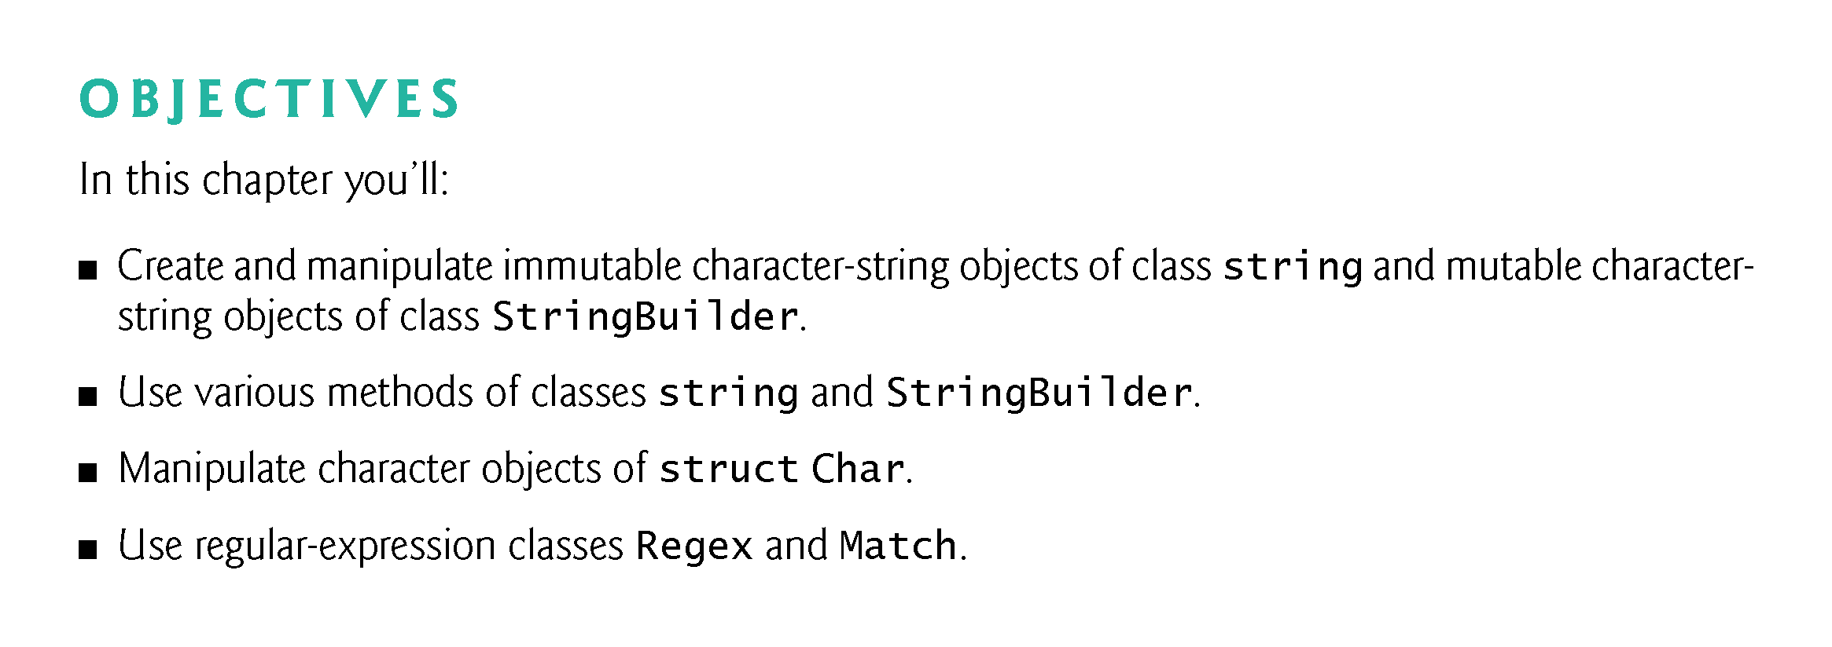

Slide 3
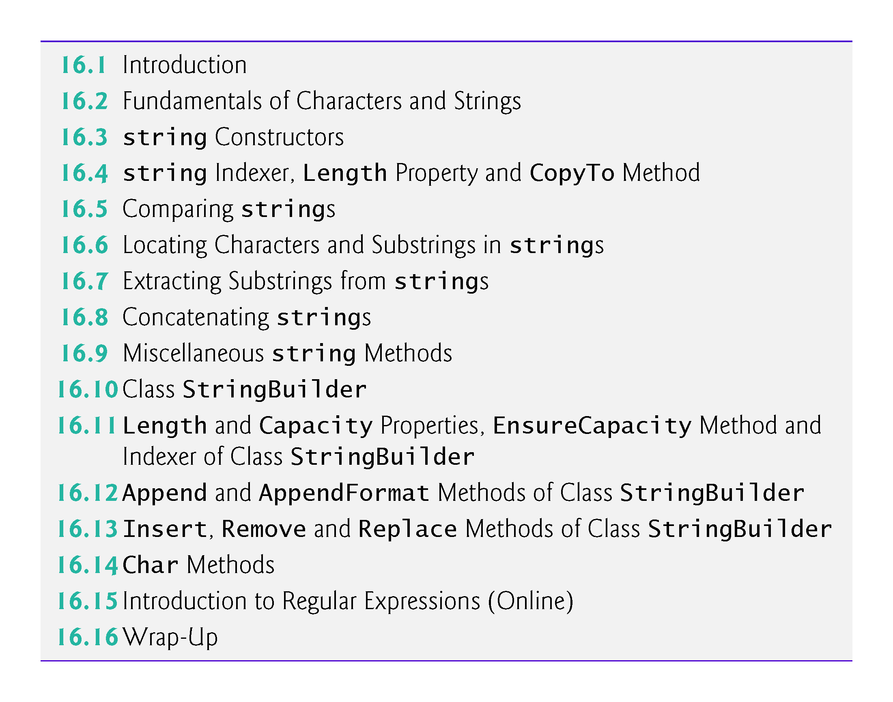

Slide 4
16.2 Fundamentals of Characters and Strings
Characters are the fundamental building blocks of C# source code.
Every program is composed of characters that, when grouped together meaningfully, create a sequence that the compiler interprets as instructions describing how to accomplish a task.
A program also can contain character constants.
A character constant is a character that’s represented as an integer value, called a character code.
The integer value 122 corresponds to the character constant 'z'.
The integer value 10 corresponds to the newline character '\n'.
Character constants are established according to the Unicode character set, an international character set that contains many more symbols and letters than does the ASCII character set (listed in Appendix C).

Slide 5
16.2 Fundamentals of Characters and Strings (cont.)
A string is a series of characters treated as a unit. These characters can be uppercase letters, lowercase letters, digits and various special characters: +, -, *, /, $ and others.
A string is an object of class string in the System namespace.
string literals are sequences of characters in double quotation marks
"John Q. Doe"
"9999 Main Street"
"Waltham, Massachusetts"
"(201) 555-1212"

Slide 6
16.2 Fundamentals of Characters and Strings (cont.)
A declaration can assign a string literal to a string reference. The declaration
string color = "blue";

Slide 7
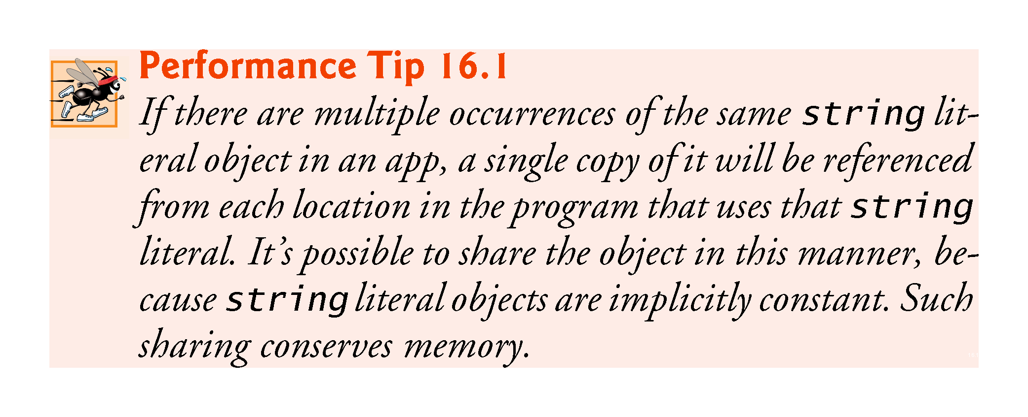

Slide 8
16.2 Fundamentals of Characters and Strings (cont.)
Verbatim Strings
On occasion, a string will contain multiple backslash characters (this often occurs in the name of a file).
To avoid excessive backslash characters, it’s possible to exclude escape sequences and interpret all the characters in a string literally, using the @ character to create what’s known as a verbatim string.
Backslashes within the double quotation marks following the @ character are not considered escape sequences.

Slide 9
16.2 Fundamentals of Characters and Strings (cont.)
For example, consider
string file = "C:\\MyFolder\\MySubFolder\\MyFile.txt";
Using the verbatim string syntax, the assignment can be altered to
string file = @"C:\MyFolder\MySubFolder\MyFile.txt";

Slide 10
16.3 string Constructors
Figure 16.1 demonstrates three string constructors.

Slide 11
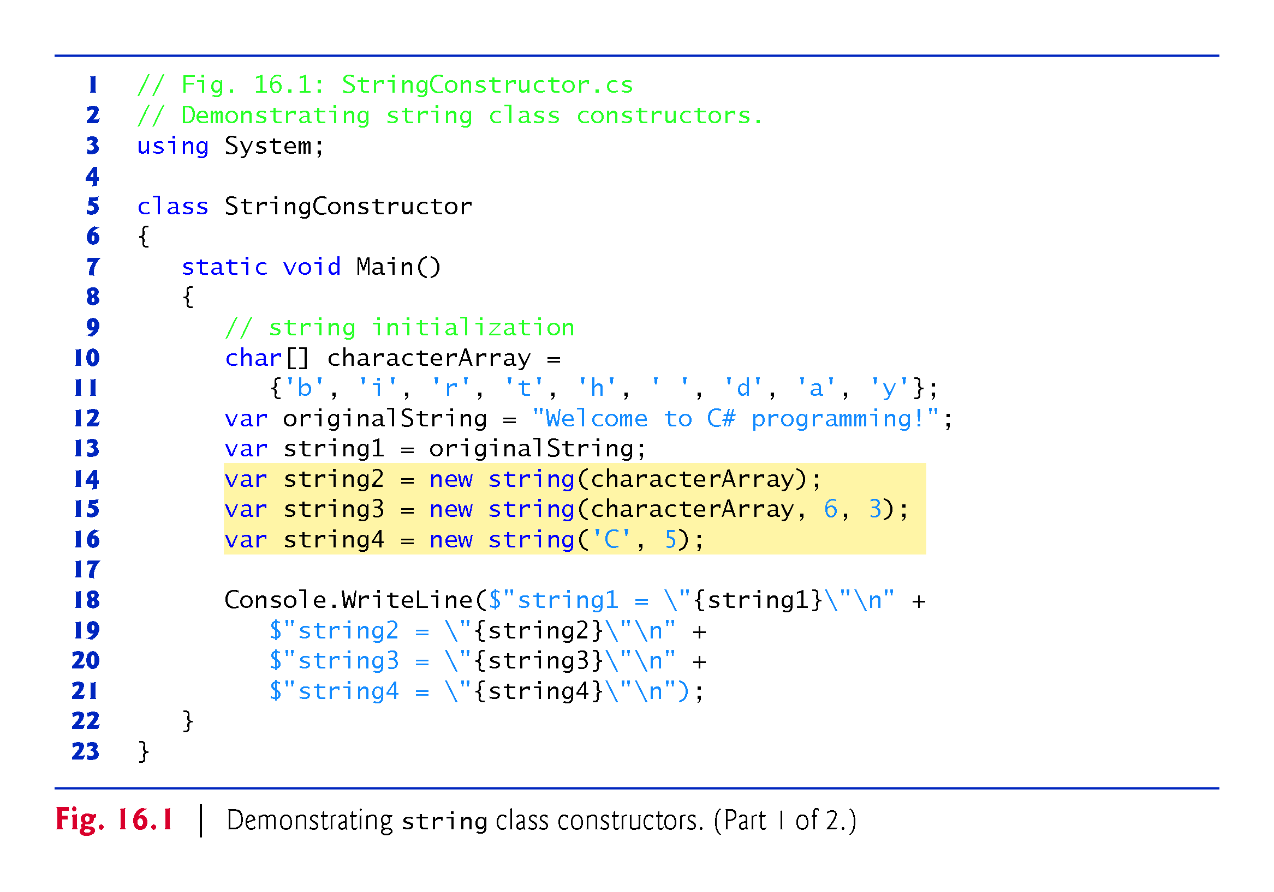

Slide 12
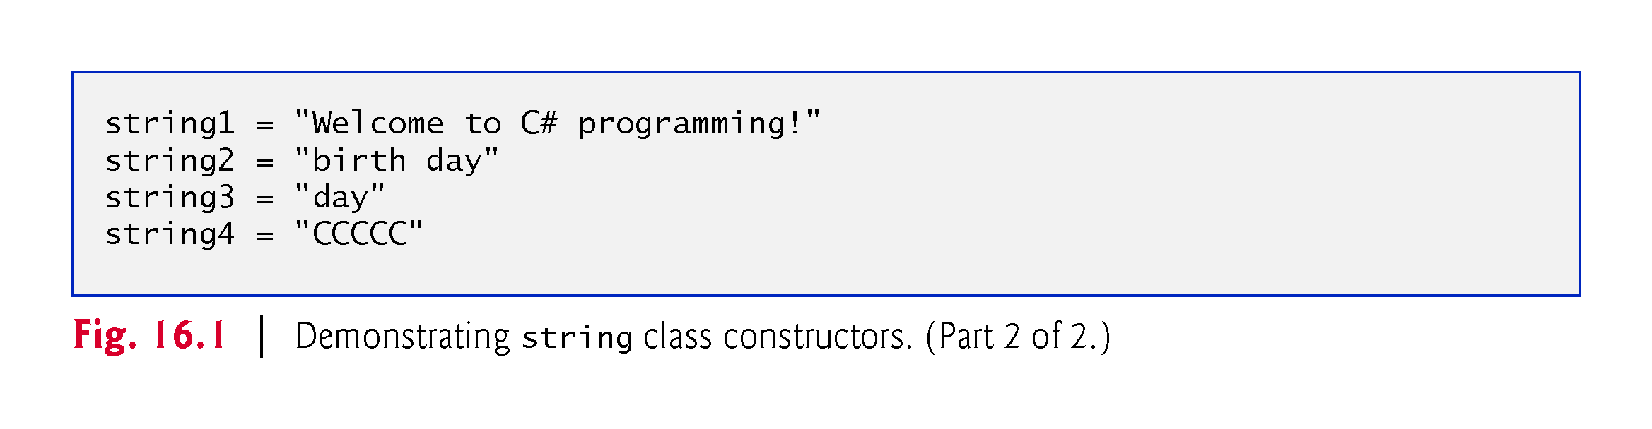

Slide 13
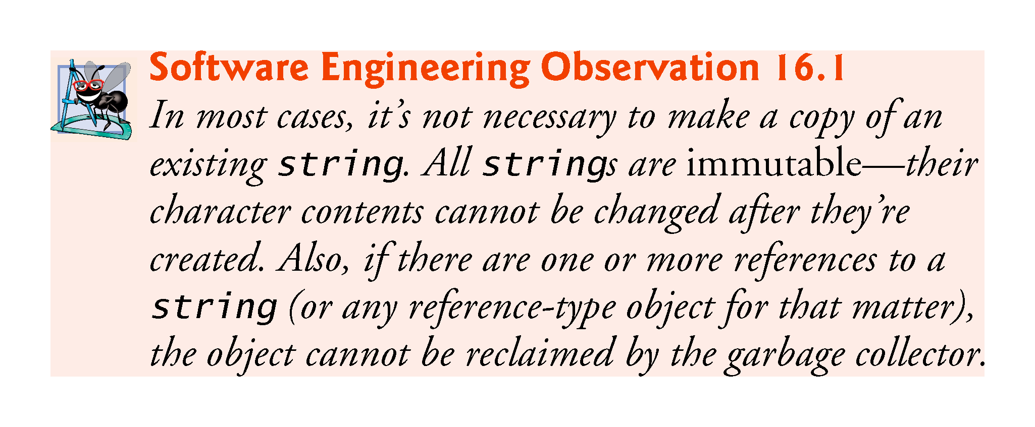

Slide 14
16.4 string Indexer, Length Property and CopyTo Method
Fig. 16.2 presents the string indexer, which facilitates the retrieval of any character in the string, and the string property Length, which returns the length of the string.
The string method CopyTo copies a specified number of characters from a string into a char array.

Slide 15
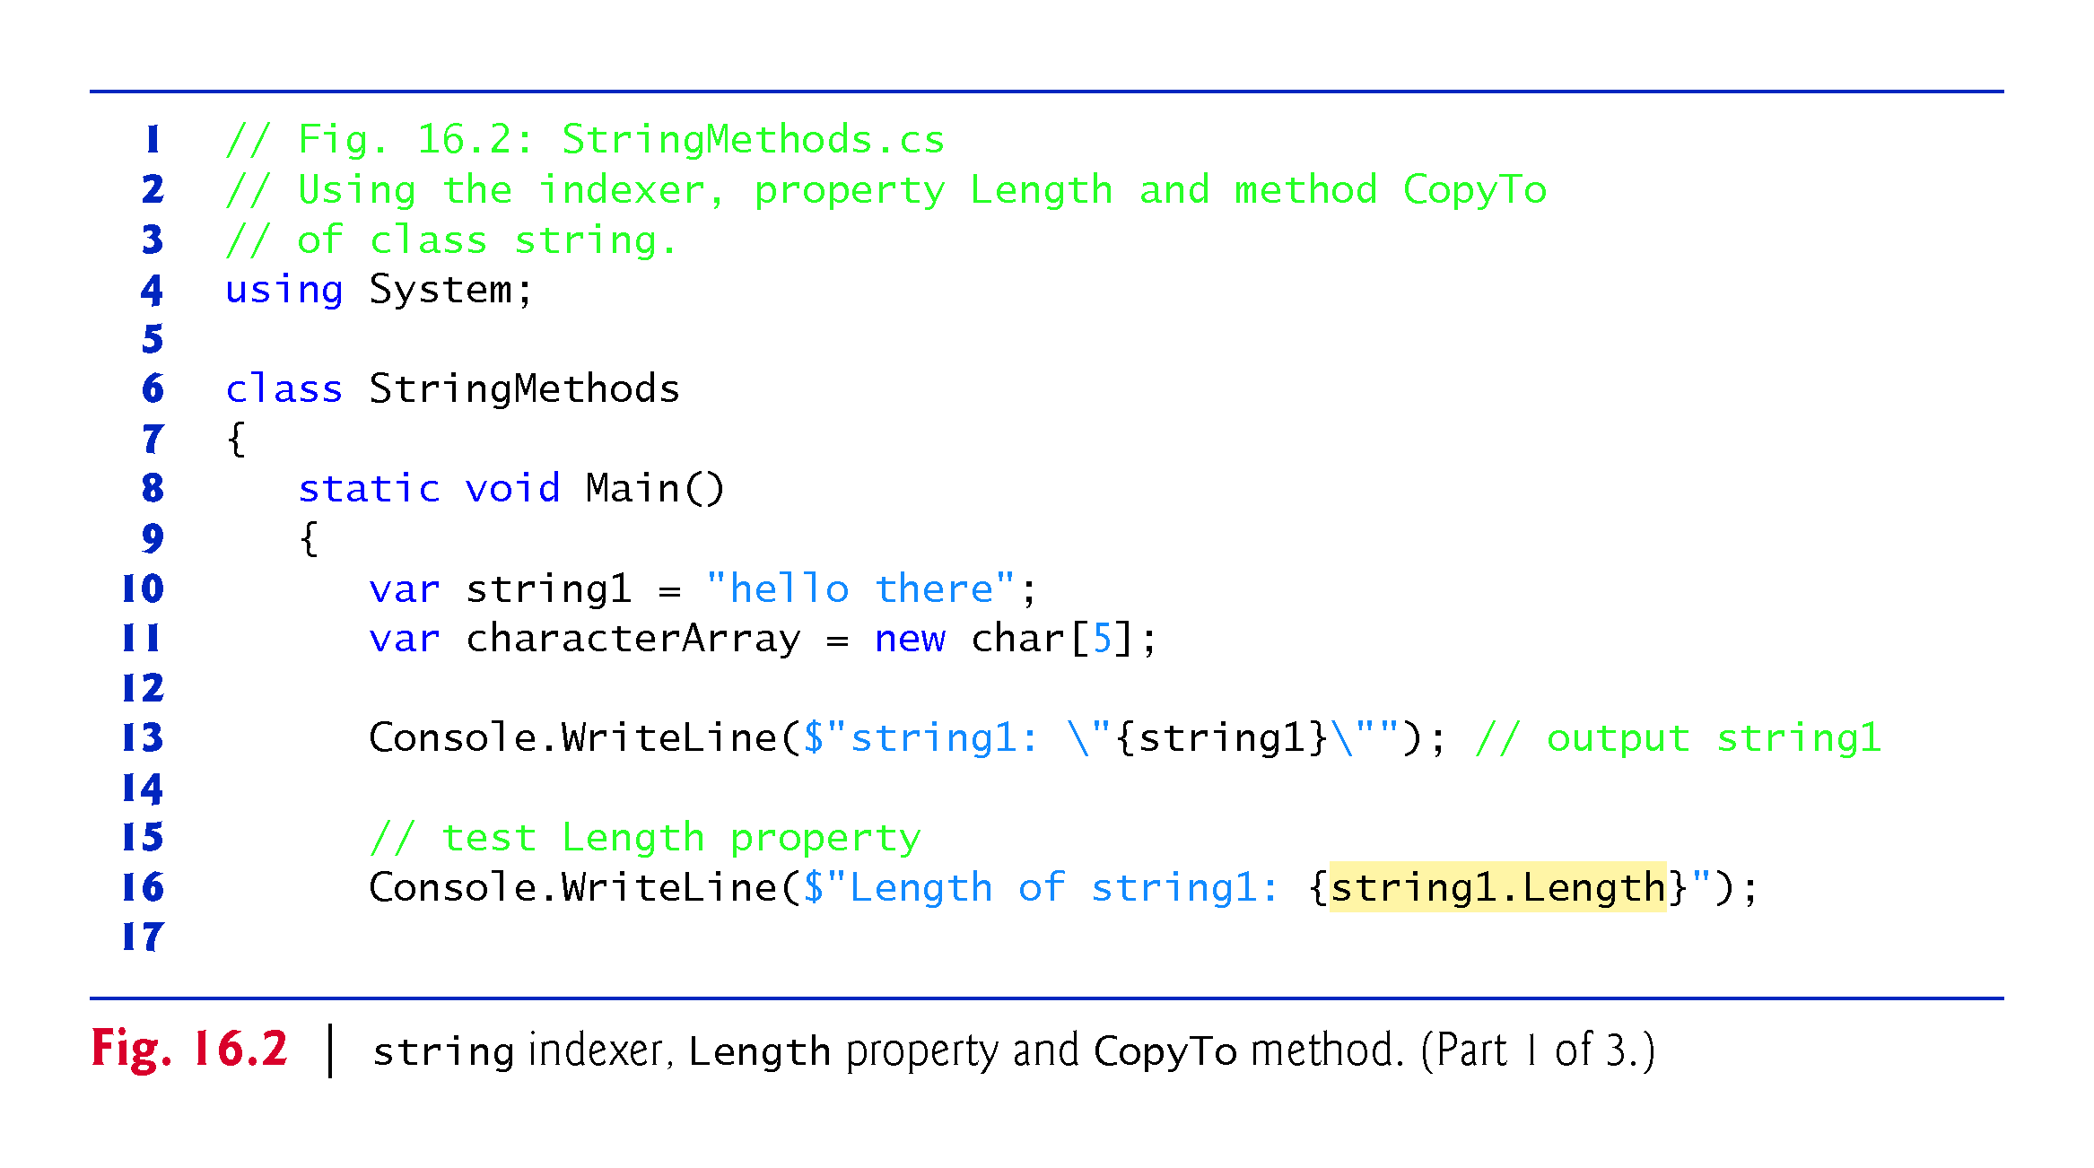

Slide 16
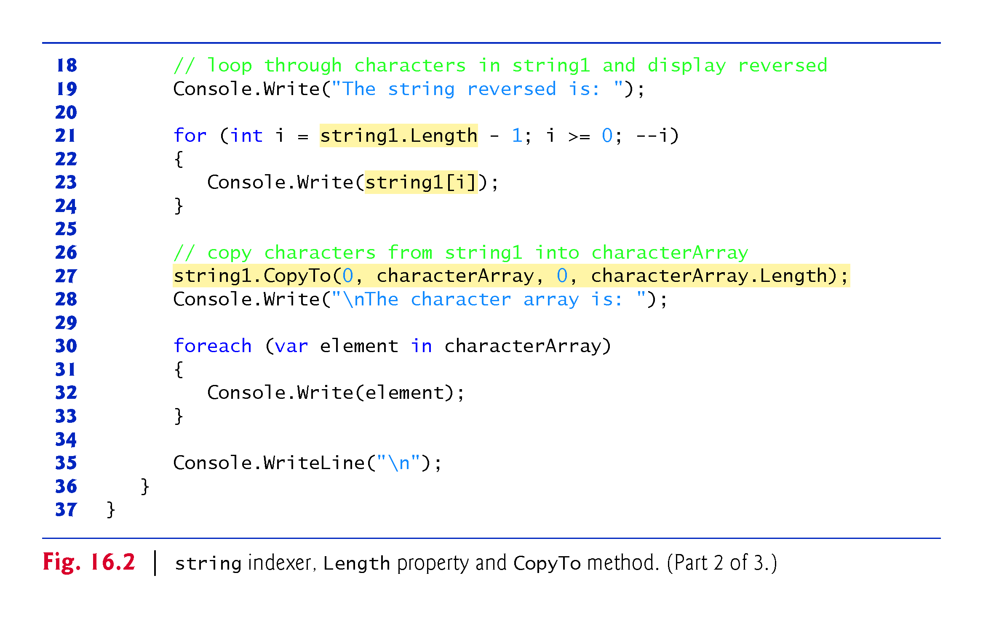

Slide 17
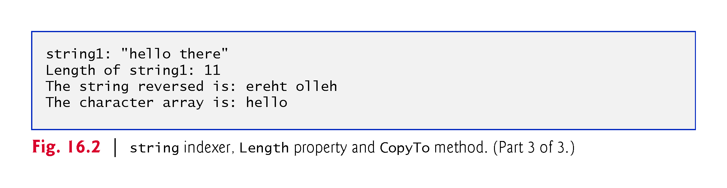

Slide 18
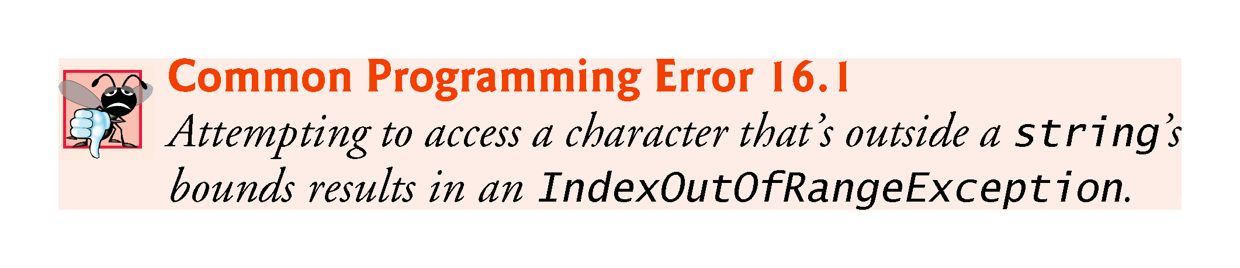

Slide 19
16.5 Comparing strings
Class string provides several ways to compare strings.
Fig. 16.3 demonstrates method Equals, method CompareTo and the equality operator (==).

Slide 20
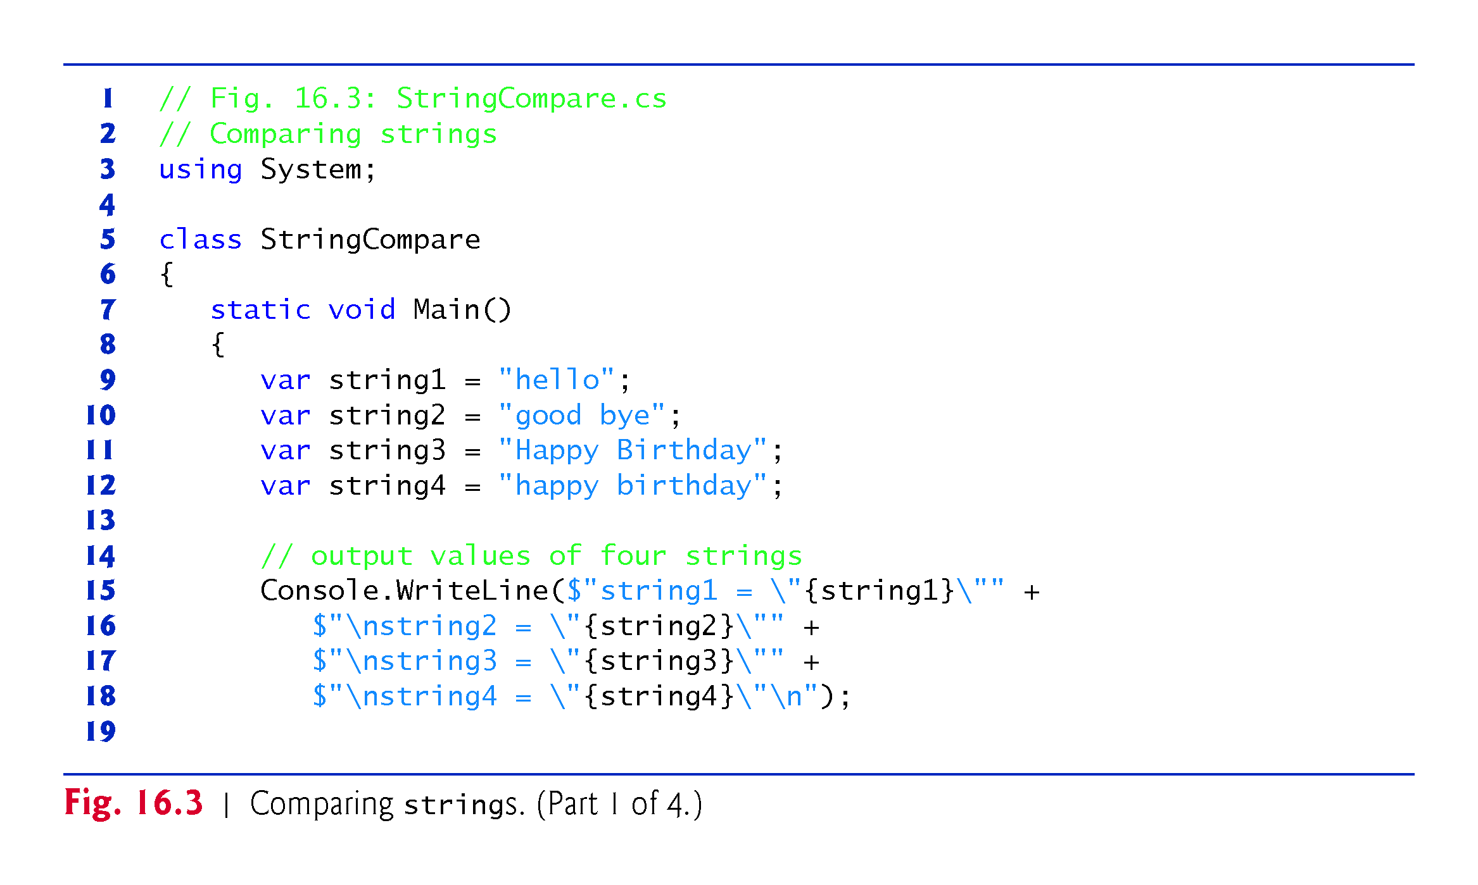

Slide 21
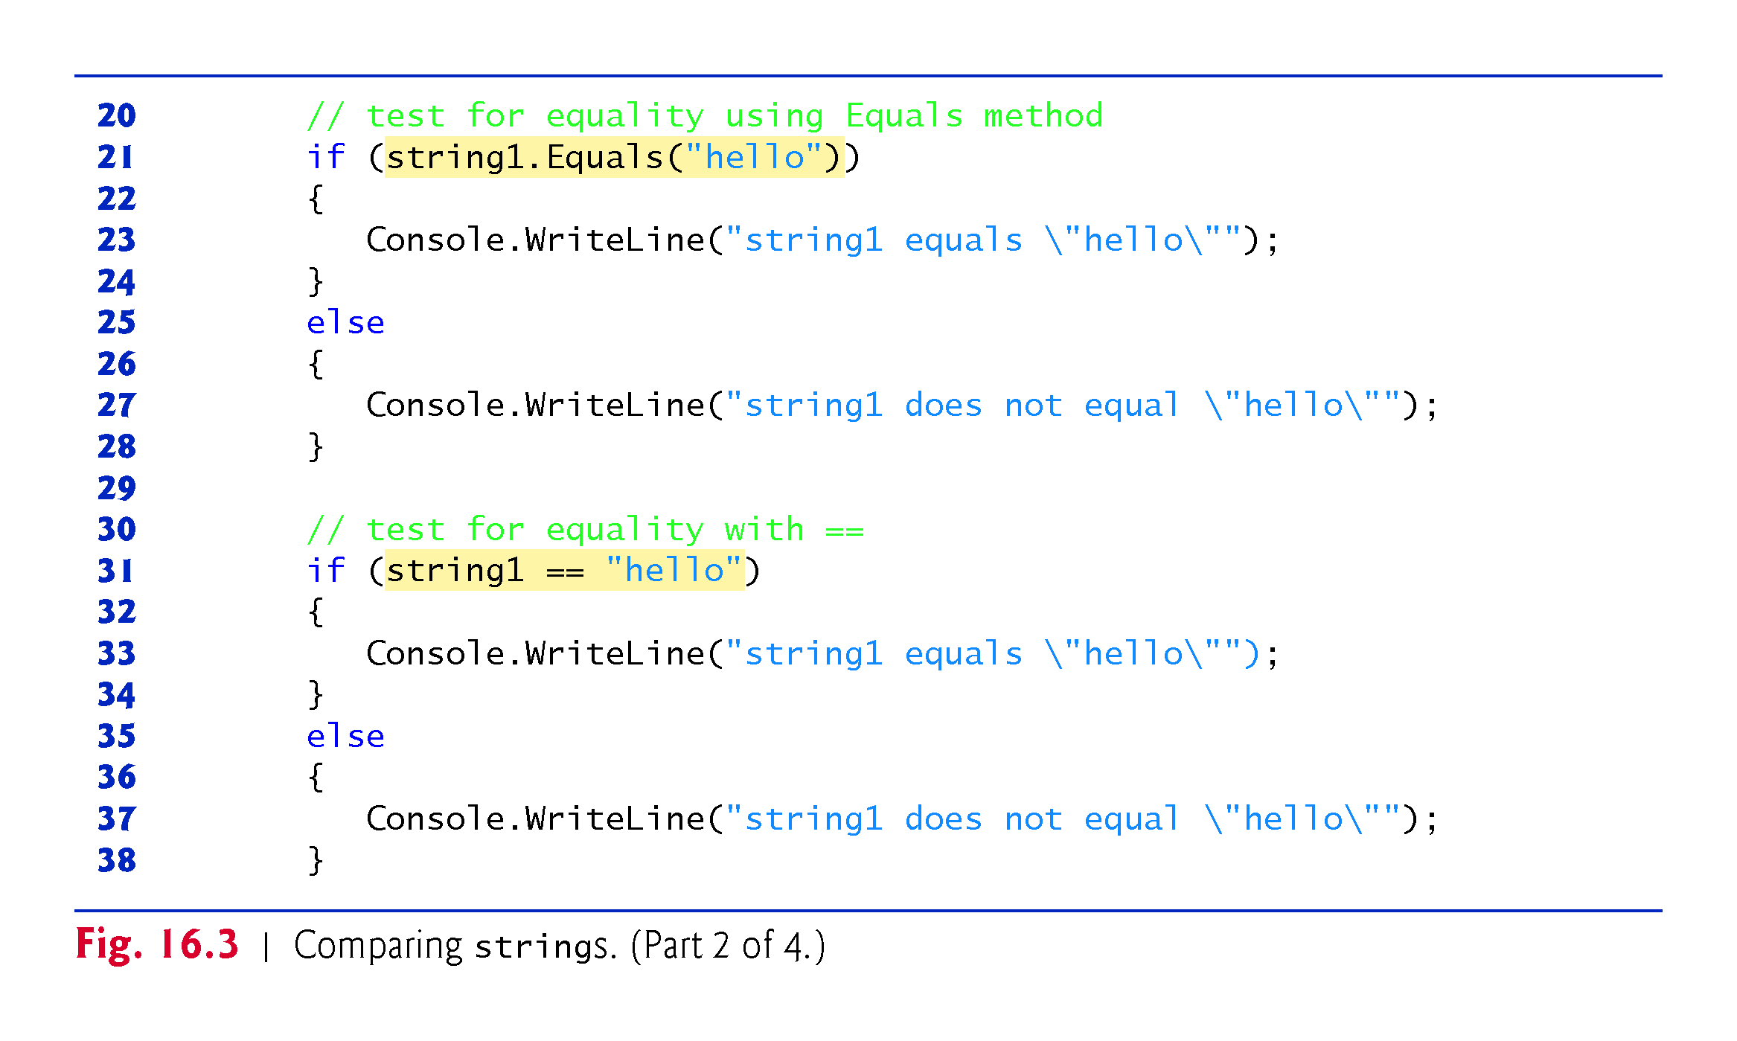

Slide 22
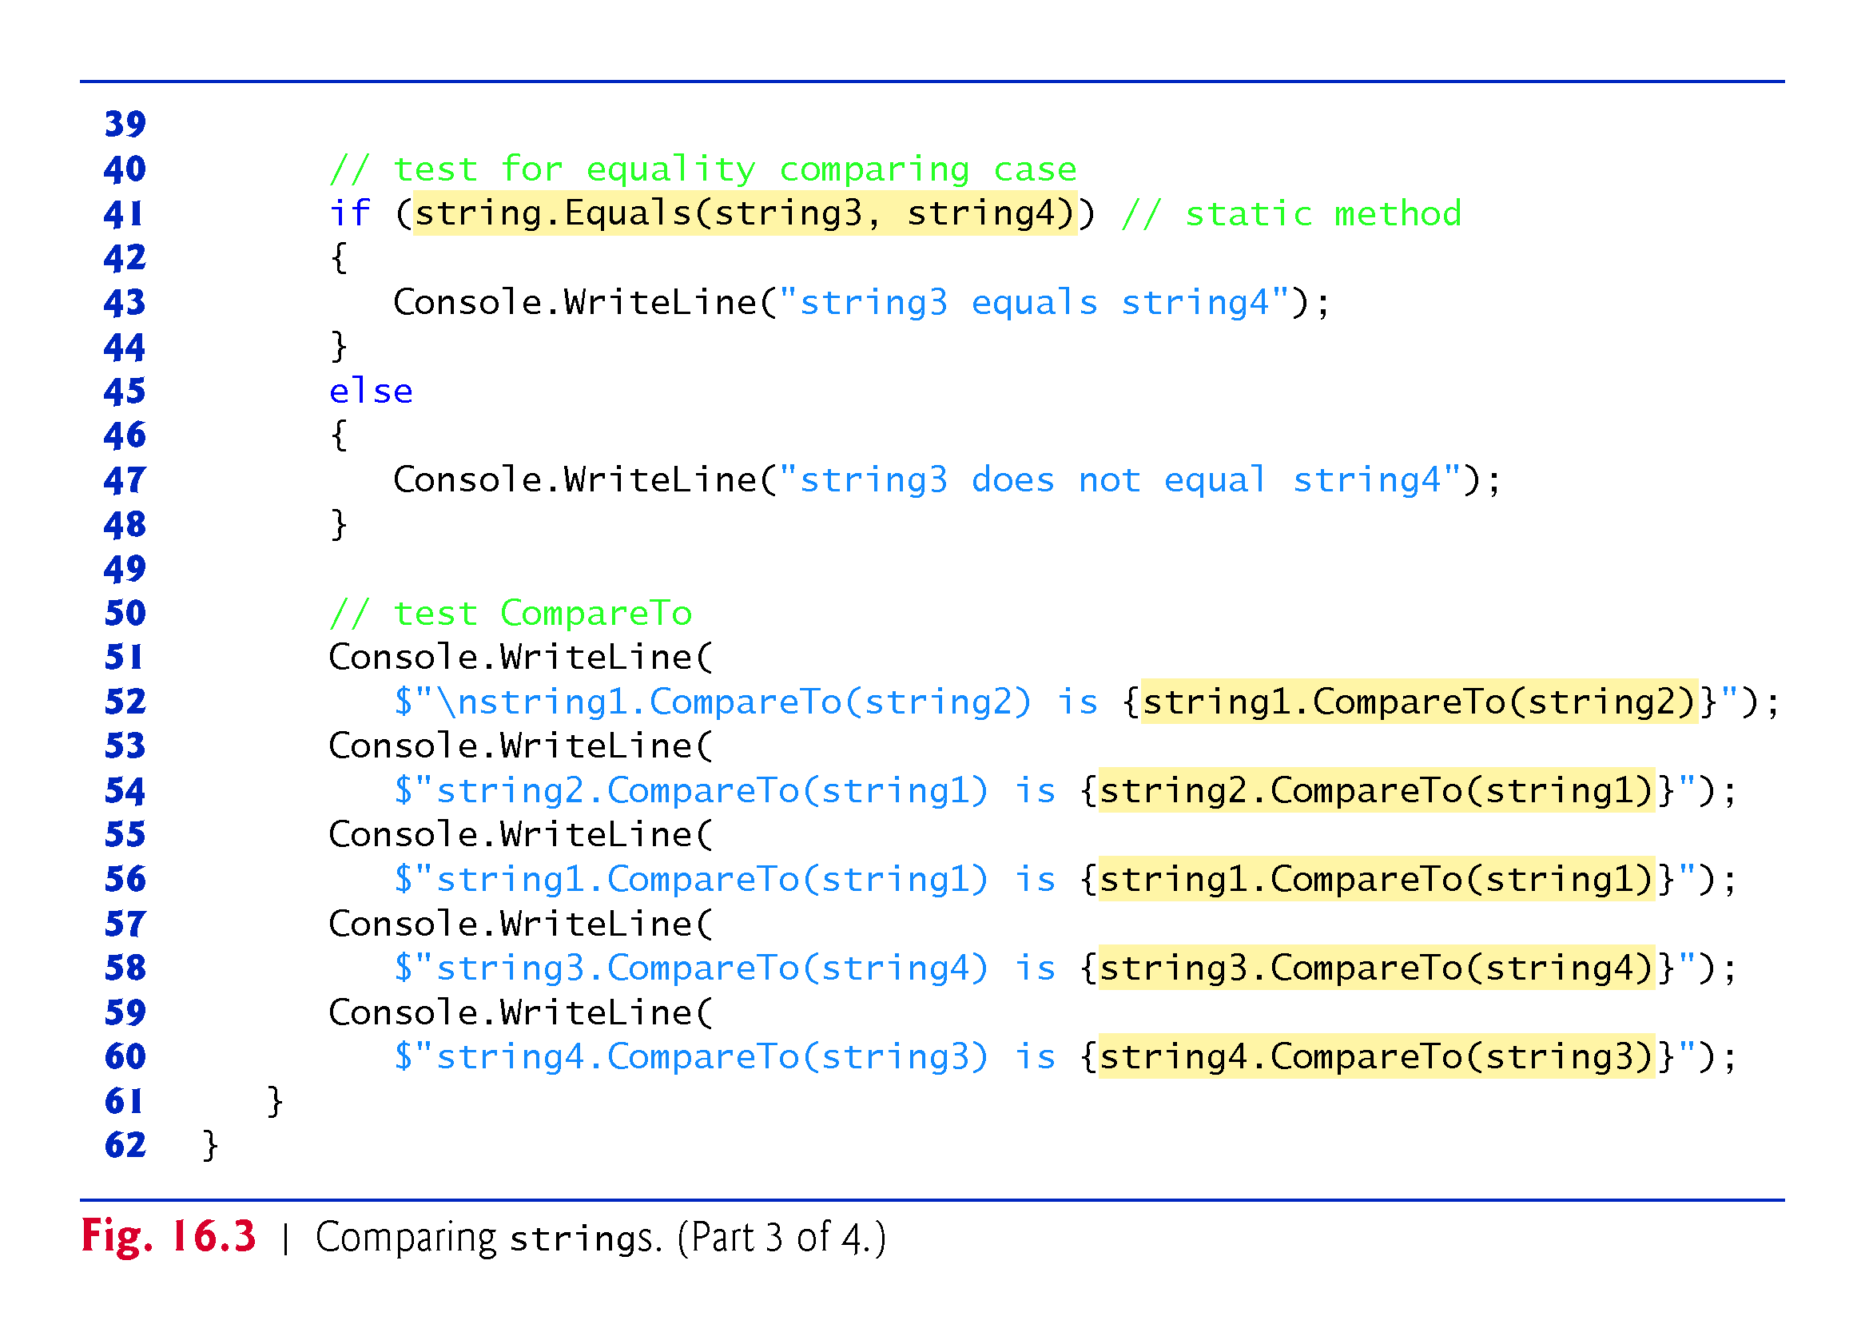

Slide 23
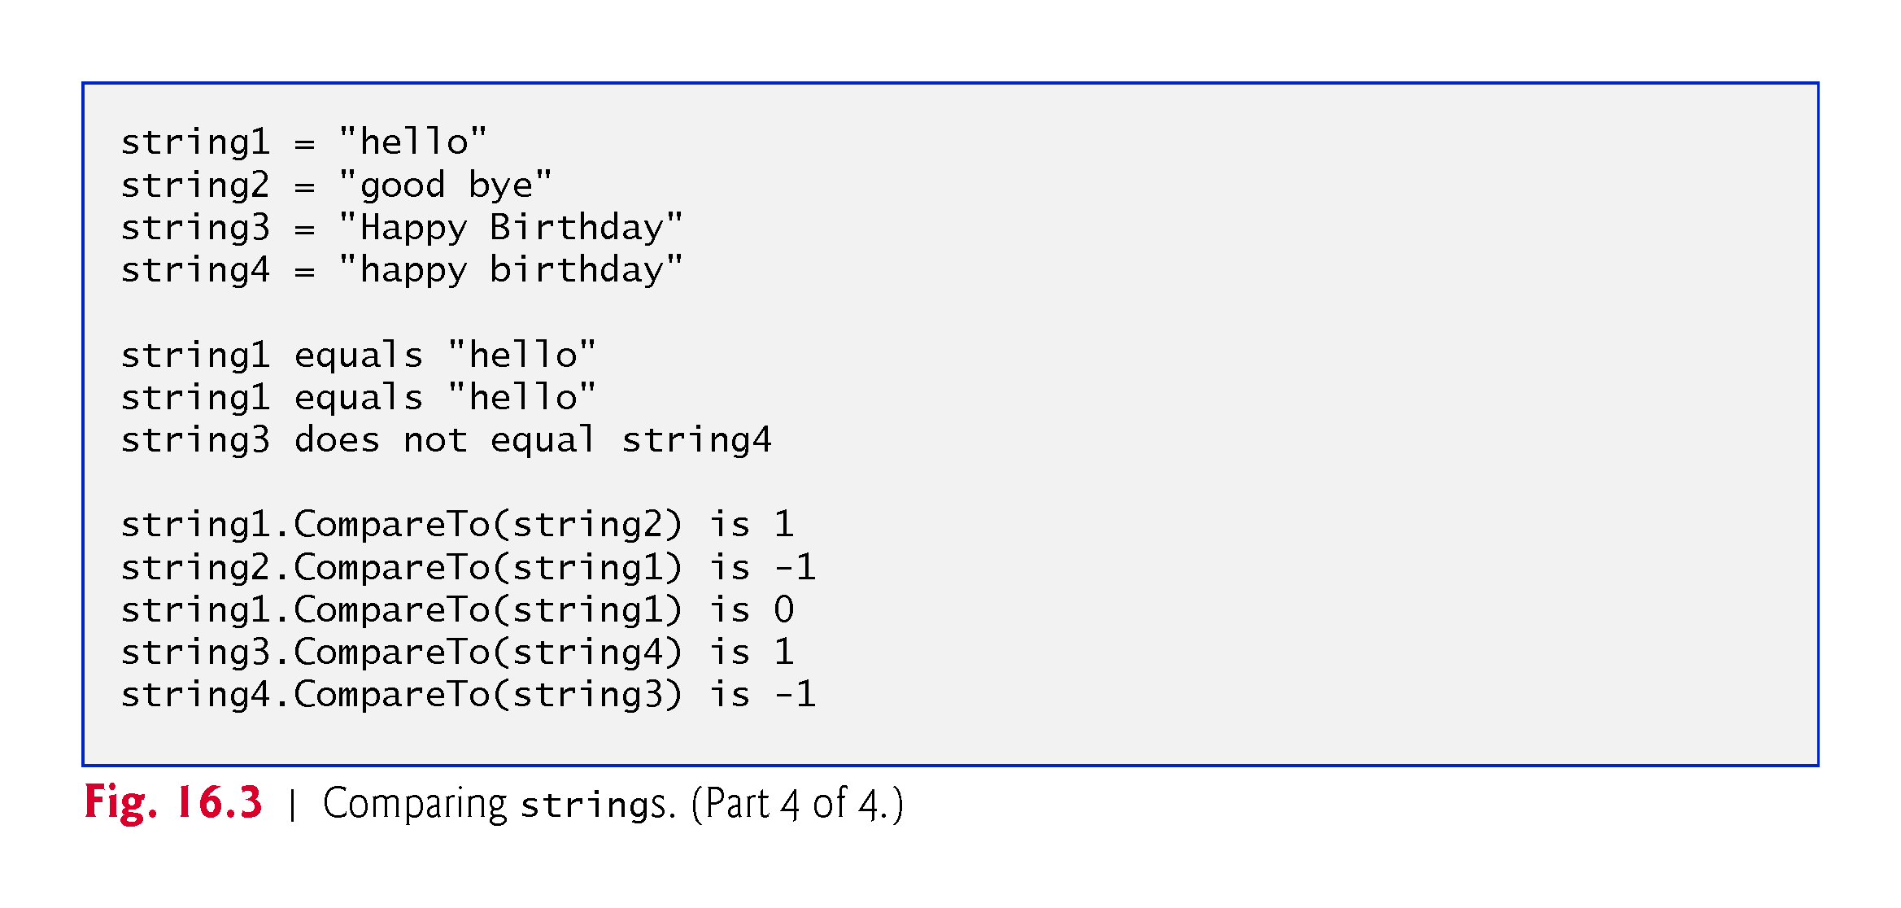

Slide 24
16.5 Comparing strings (cont.)
Figure 16.4 shows how to test whether a string instance begins or ends with a given string.

Slide 25
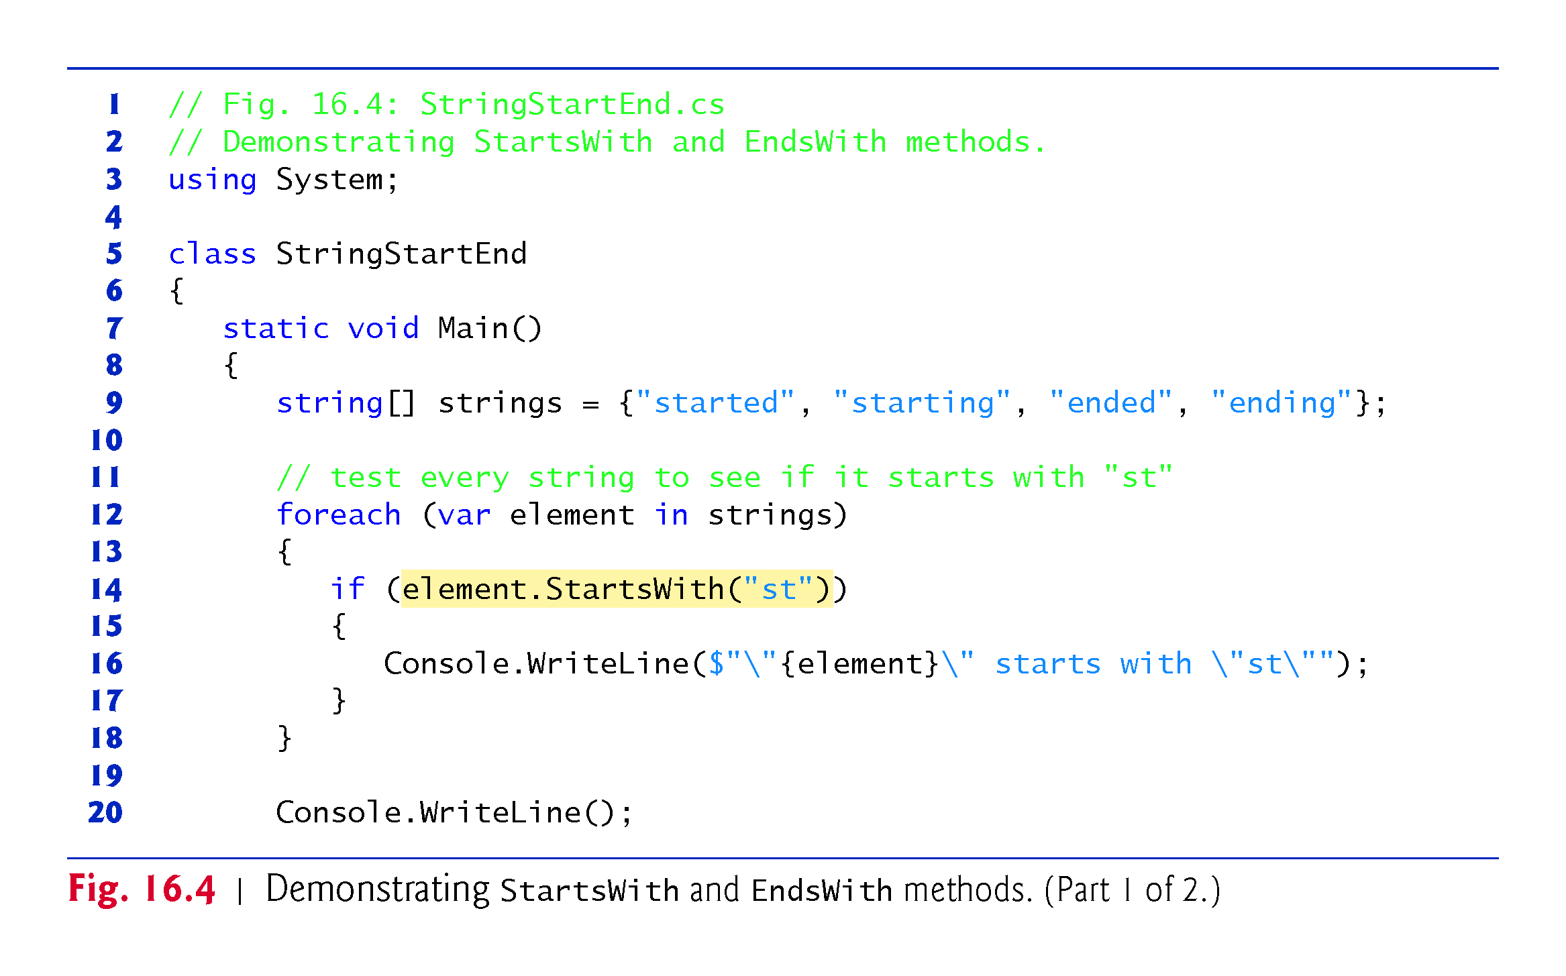

Slide 26
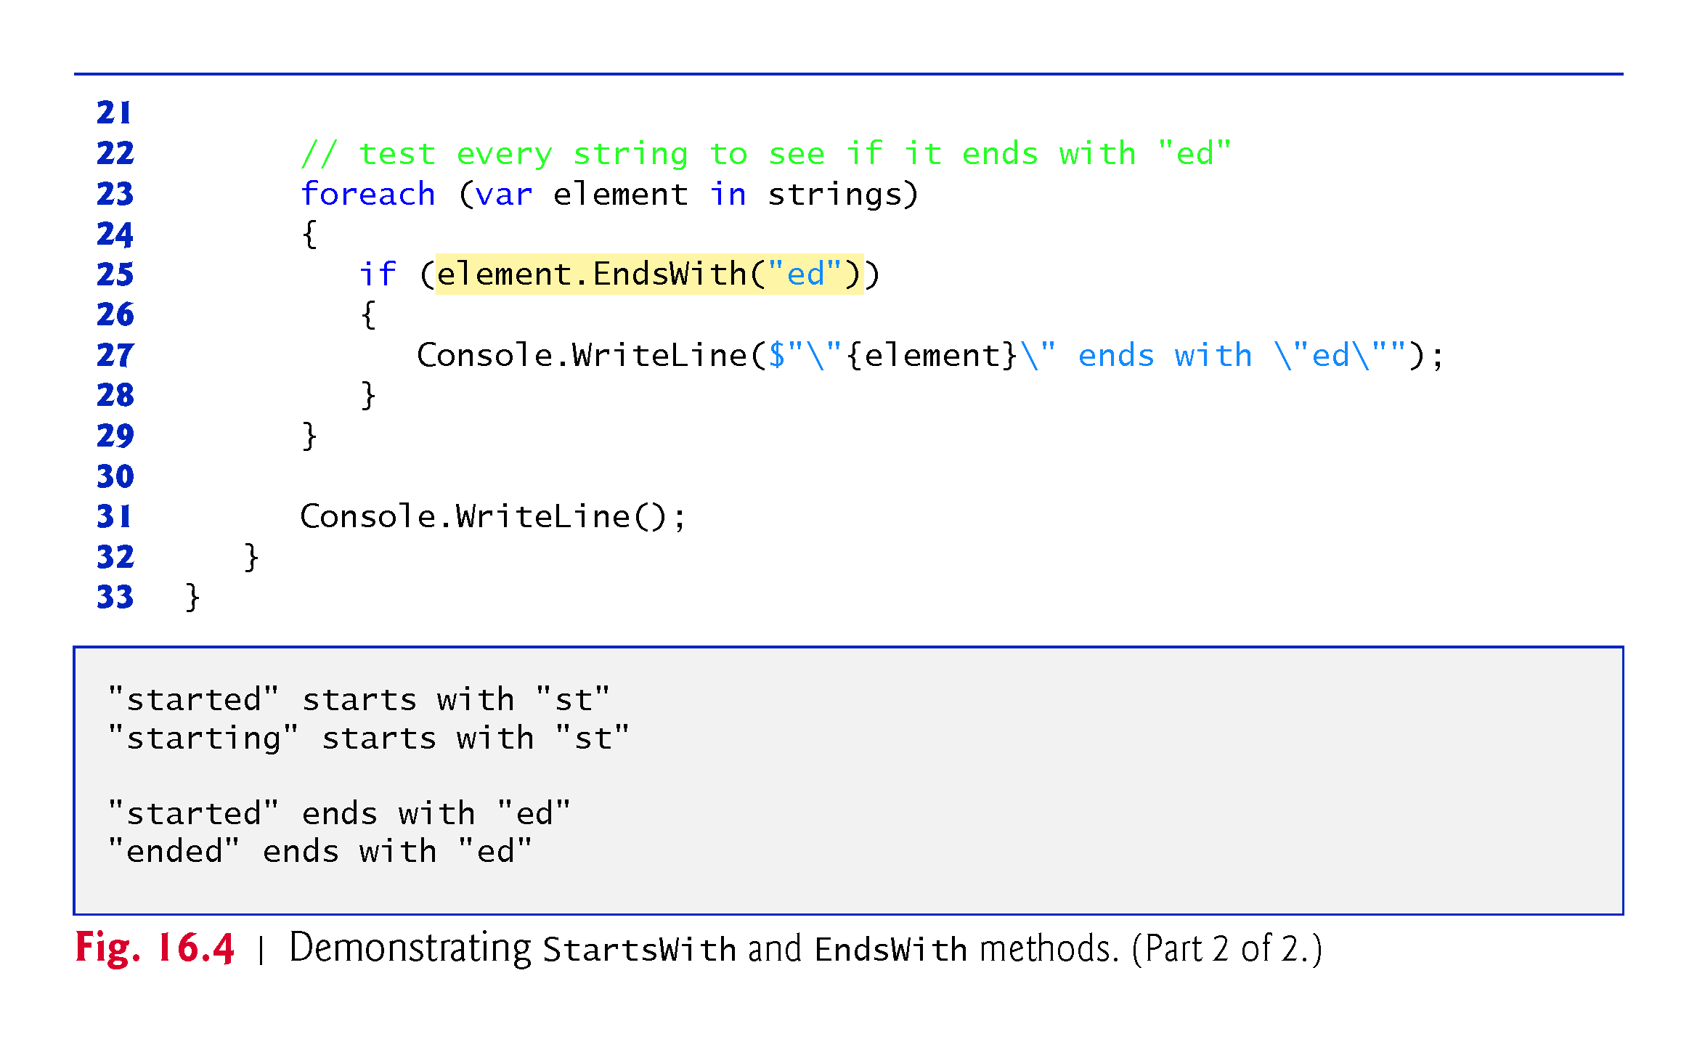

Slide 27
16.6 Locating Characters and Substrings in strings
In many apps, it’s necessary to search for a character or set of characters in a string.
For example, a programmer creating a word processor would want to provide capabilities for searching through documents.
Fig. 16.5 demonstrates some of the many versions of string methods IndexOf, IndexOfAny, LastIndexOf and LastIndexOfAny, which search for a specified character or substring in a string.
We perform all searches in this example on the string letters (initialized with "abcdefghijklmabcdefghijklm") located in method Main of class StringIndexMethods.

Slide 28
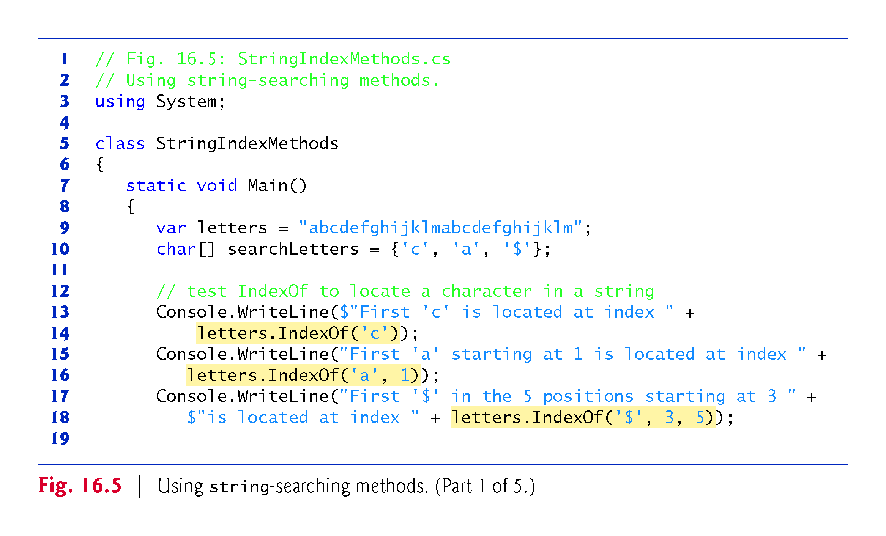

Slide 29
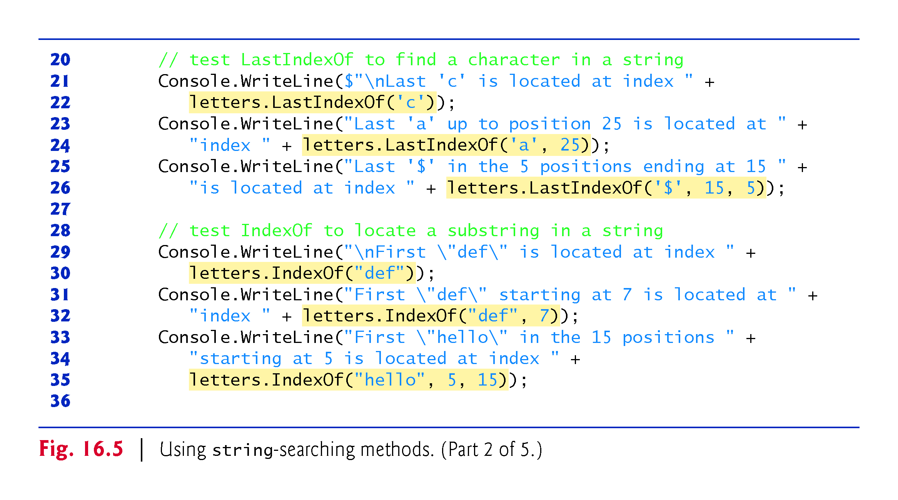

Slide 30
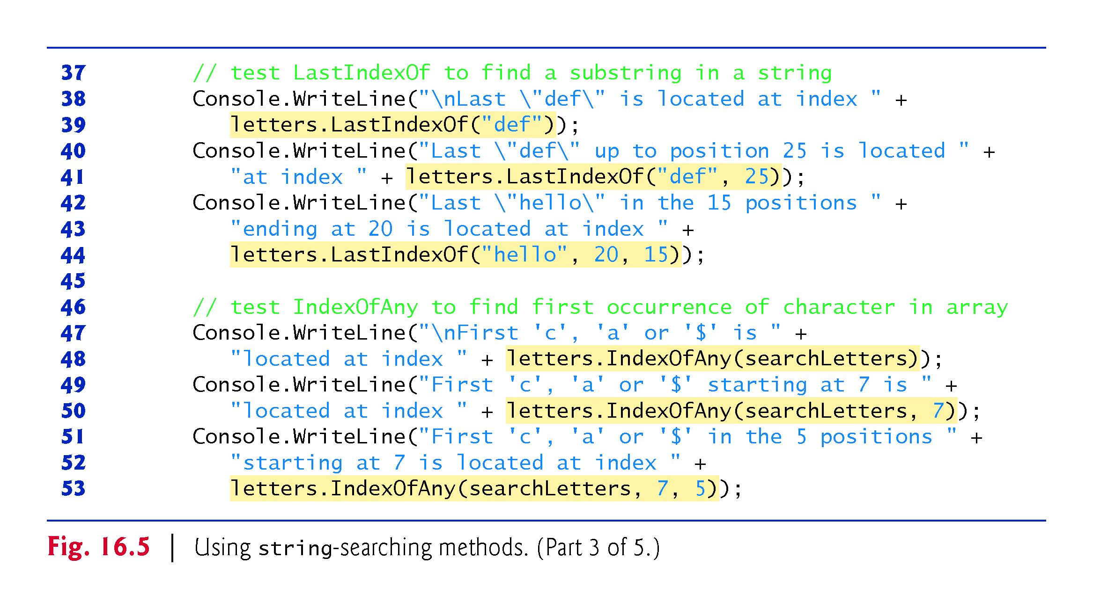

Slide 31
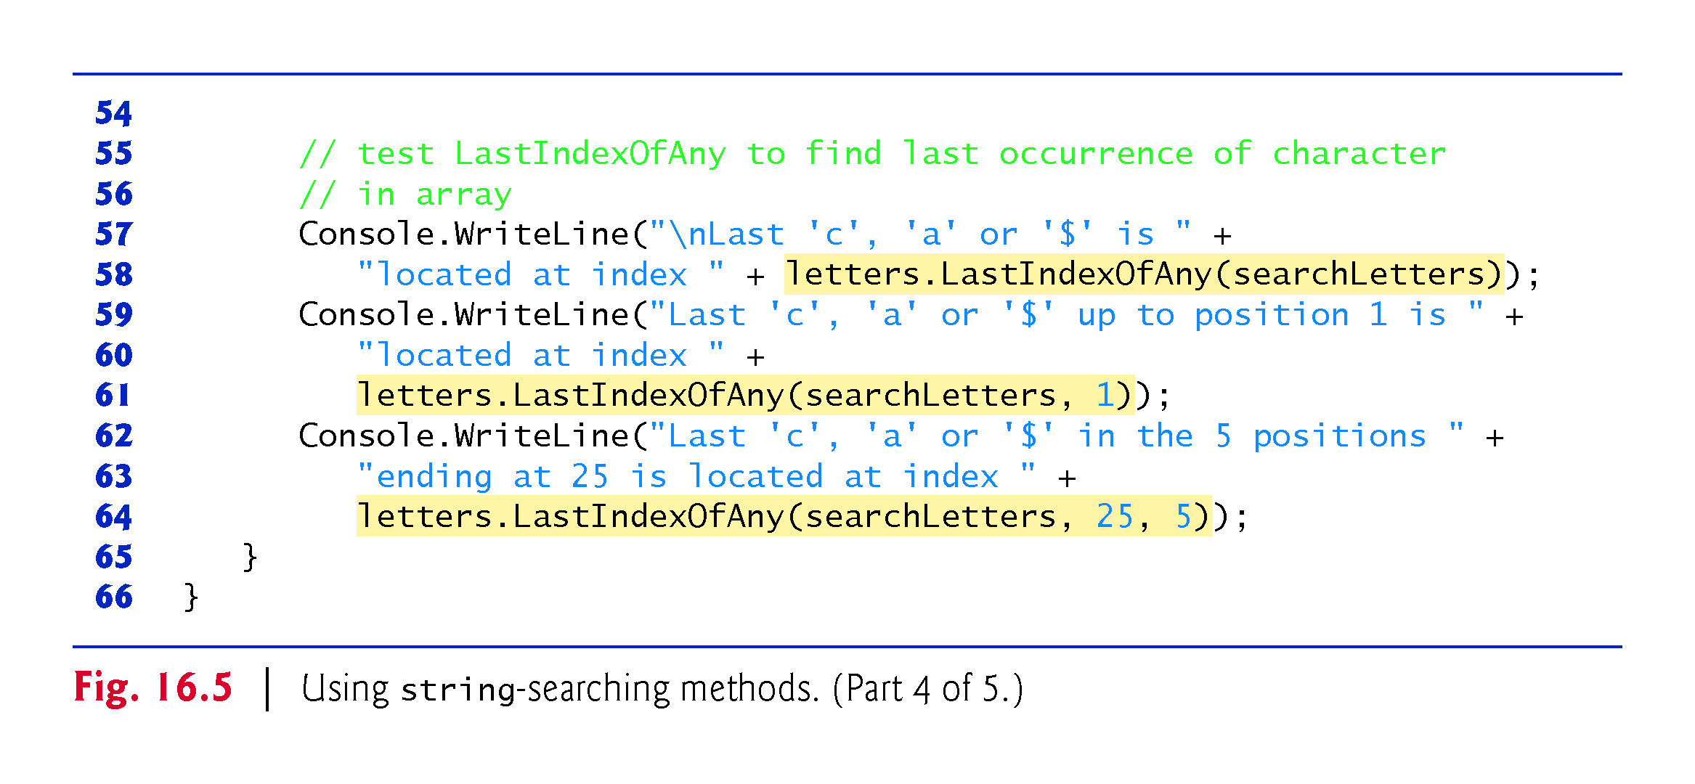

Slide 32
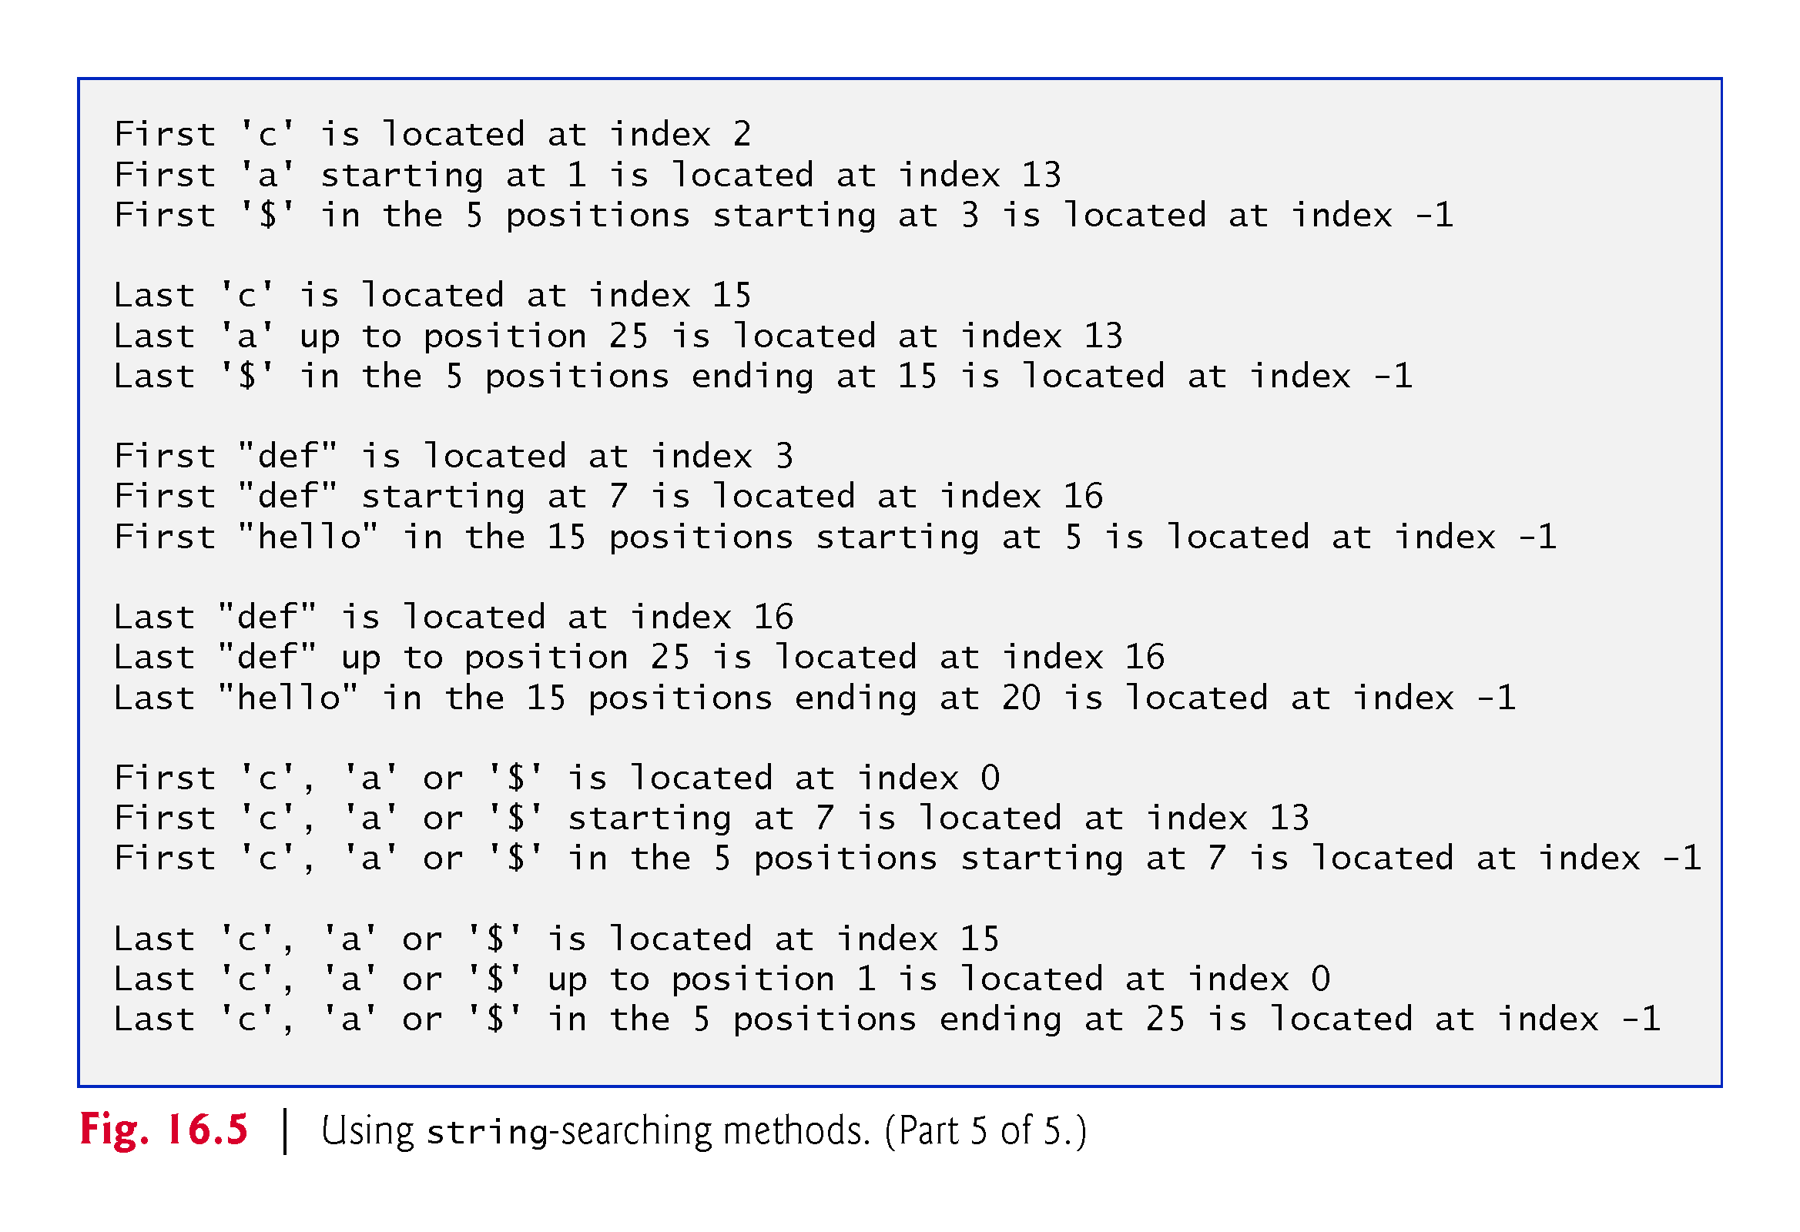

Slide 33
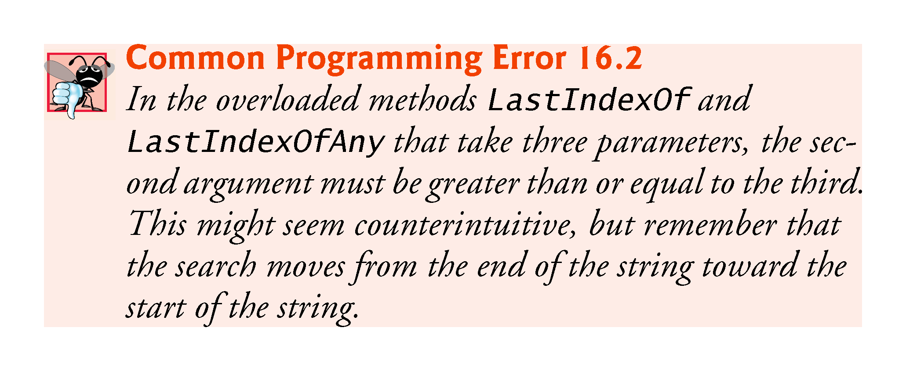

Slide 34
16.7 Extracting Substrings from strings
Class string provides two Substring methods, which create a new string by copying part of an existing string.
Each method returns a new string.
Fig. 16.6 demonstrates the use of both methods.

Slide 35
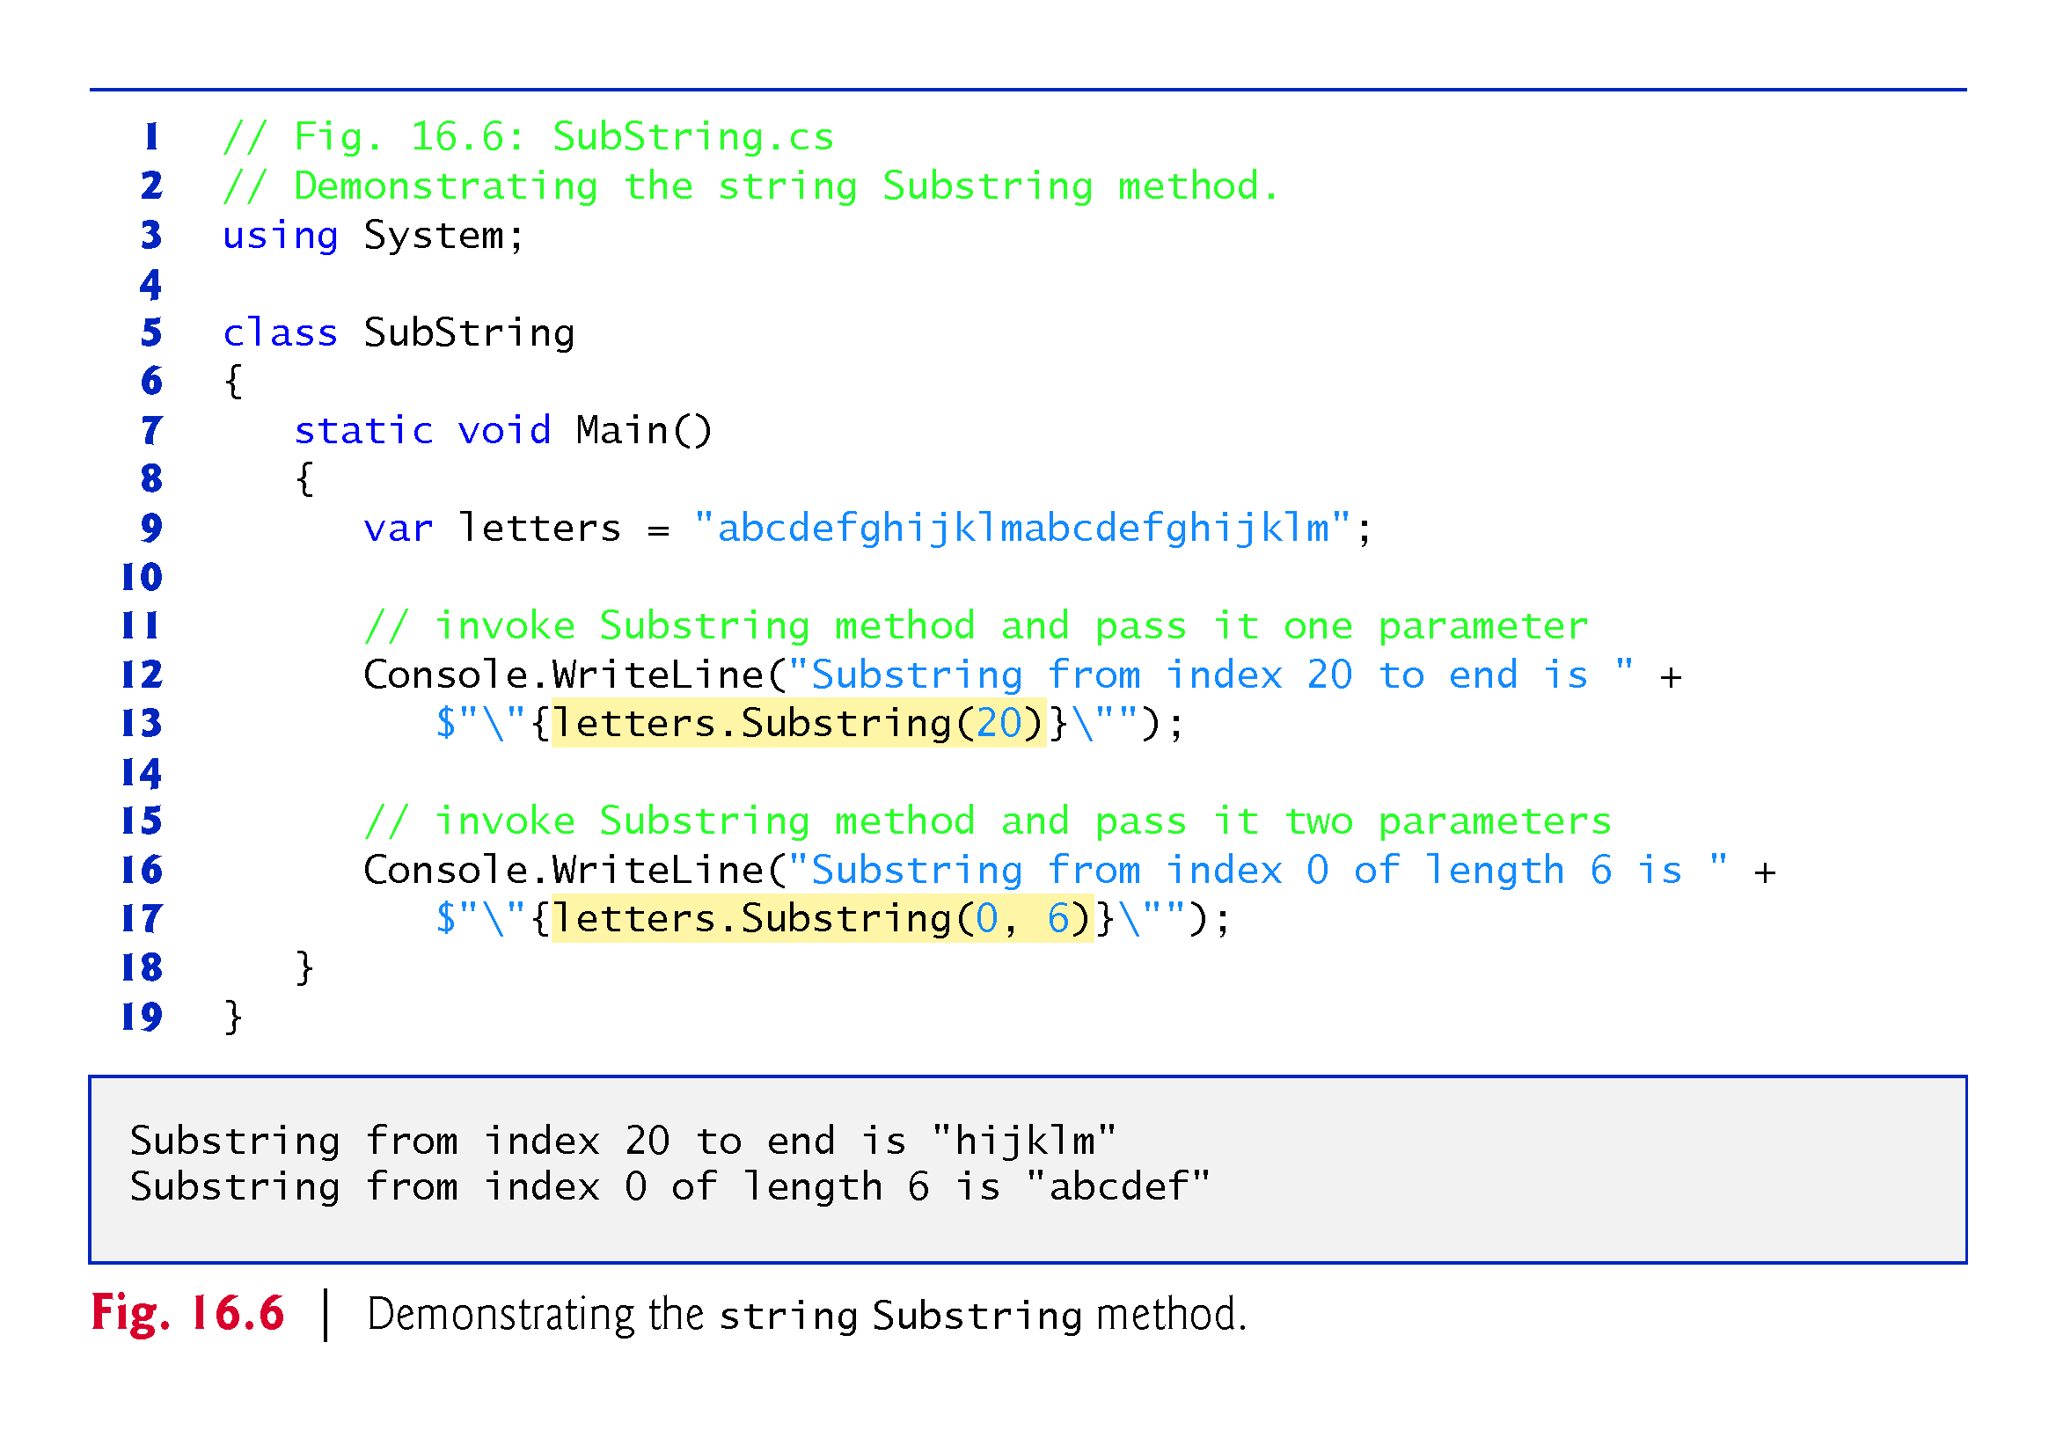

Slide 36
16.8 Concatenating strings
The + operator is not the only way to perform string concatenation.
The static method Concat of class string (Fig. 16.7) concatenates two strings and returns a new string containing the combined characters from both original strings.

Slide 37
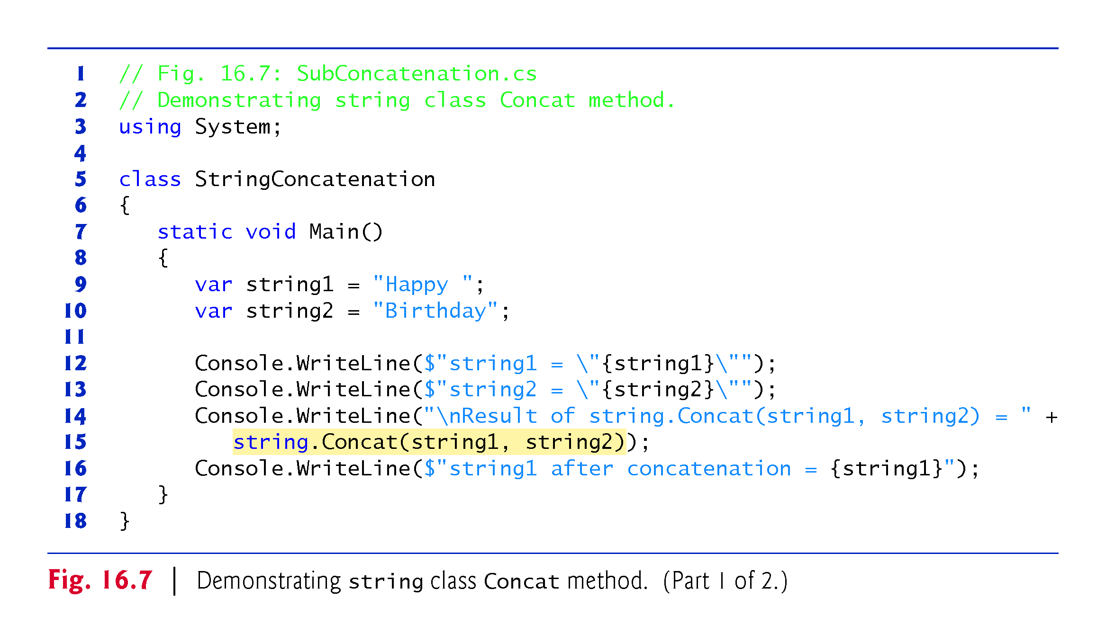

Slide 38
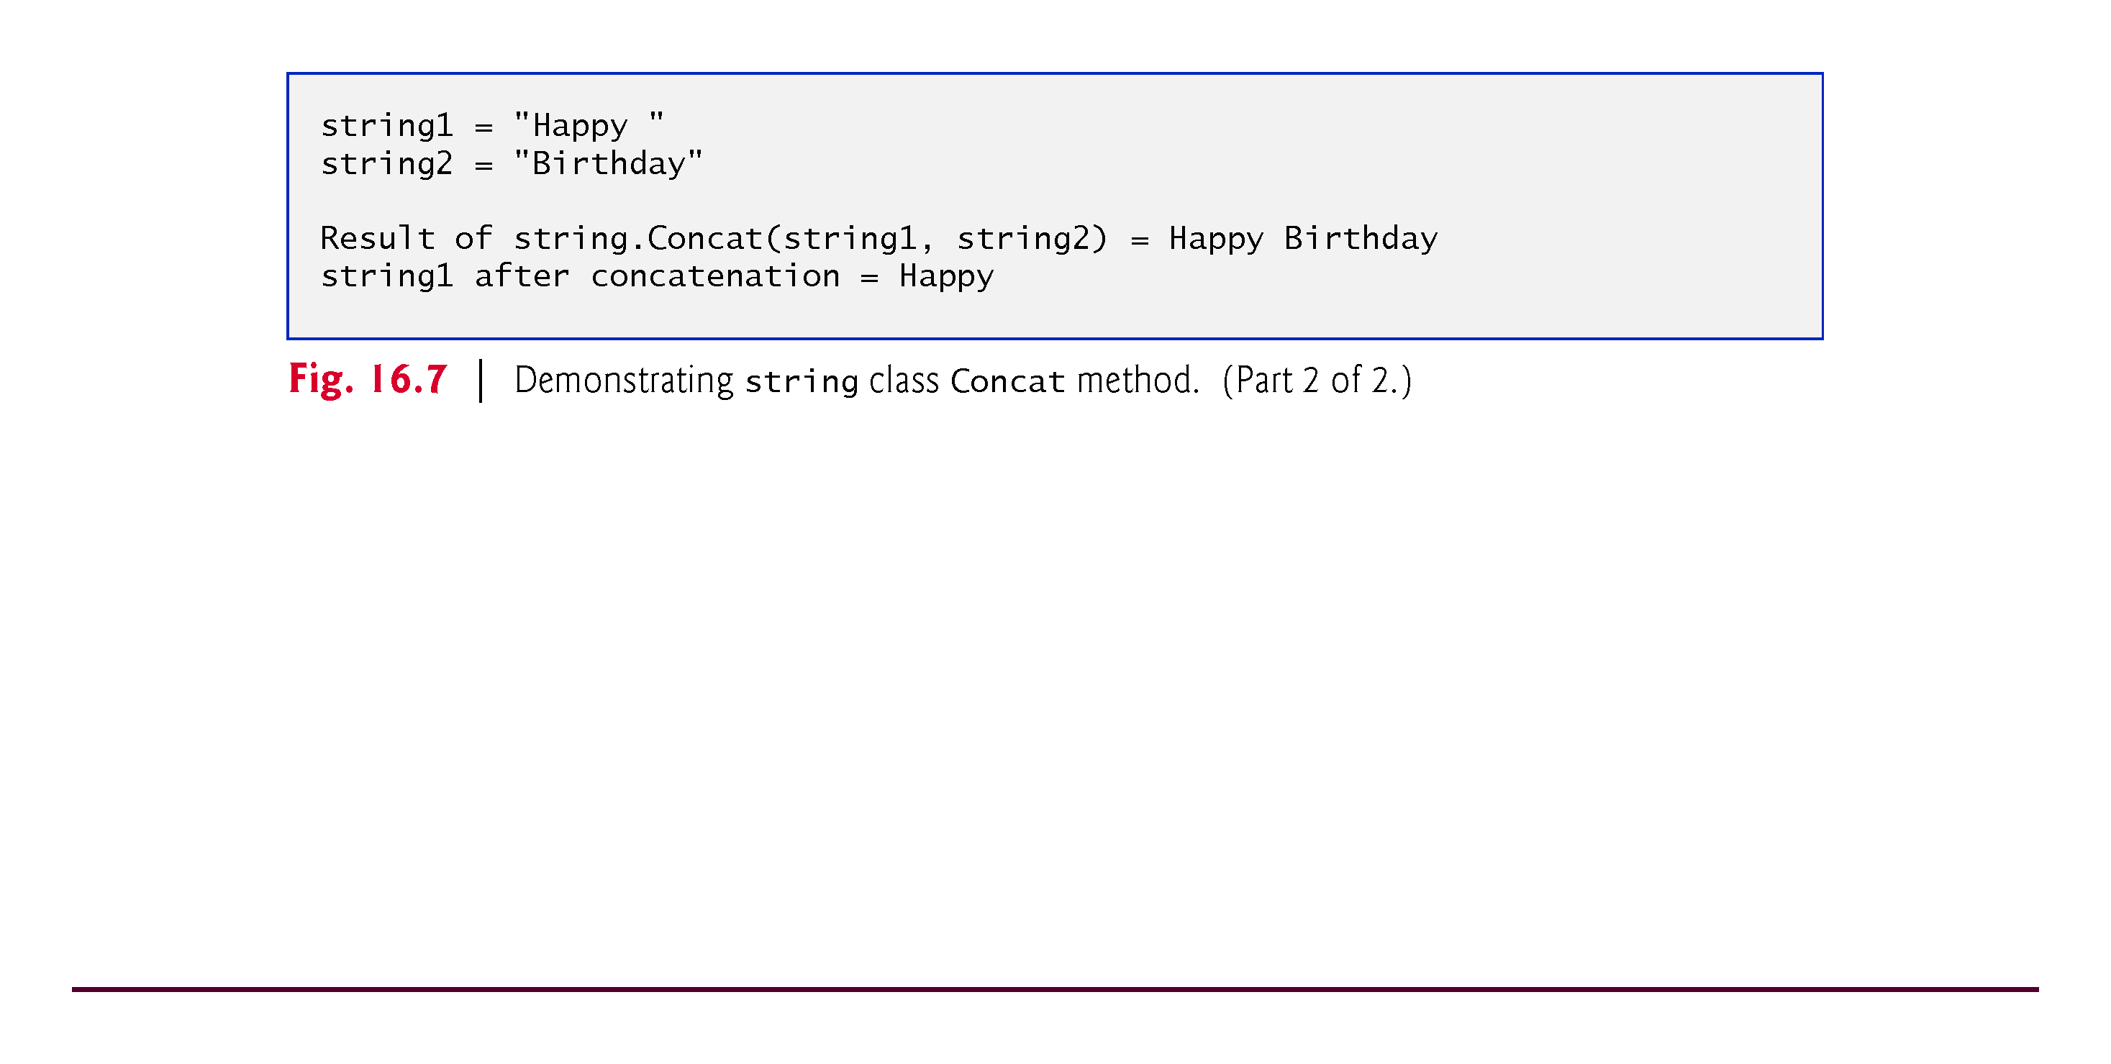

Slide 39
16.9 Miscellaneous string Methods
Class string provides several methods that return modified copies of strings.
The app in Fig. 16.8 demonstrates string methods Replace, ToLower, ToUpper and Trim.

Slide 40
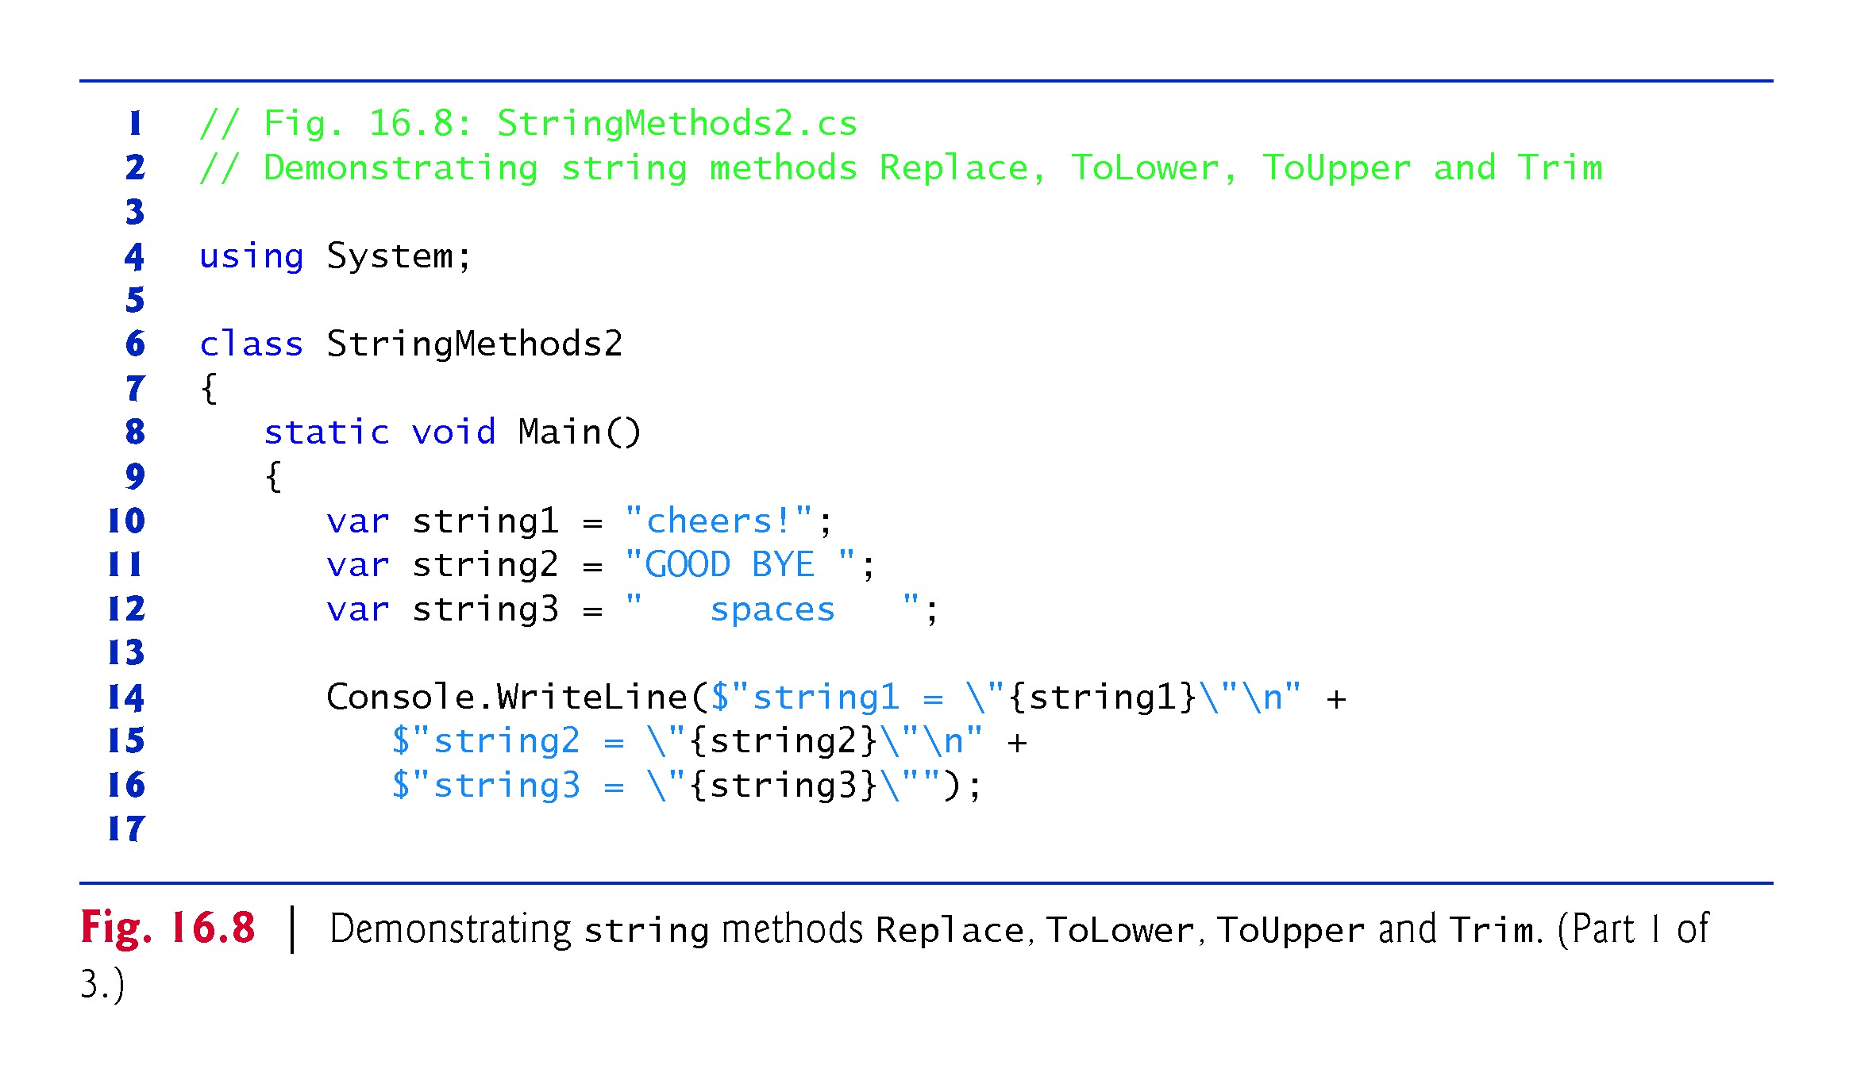

Slide 41
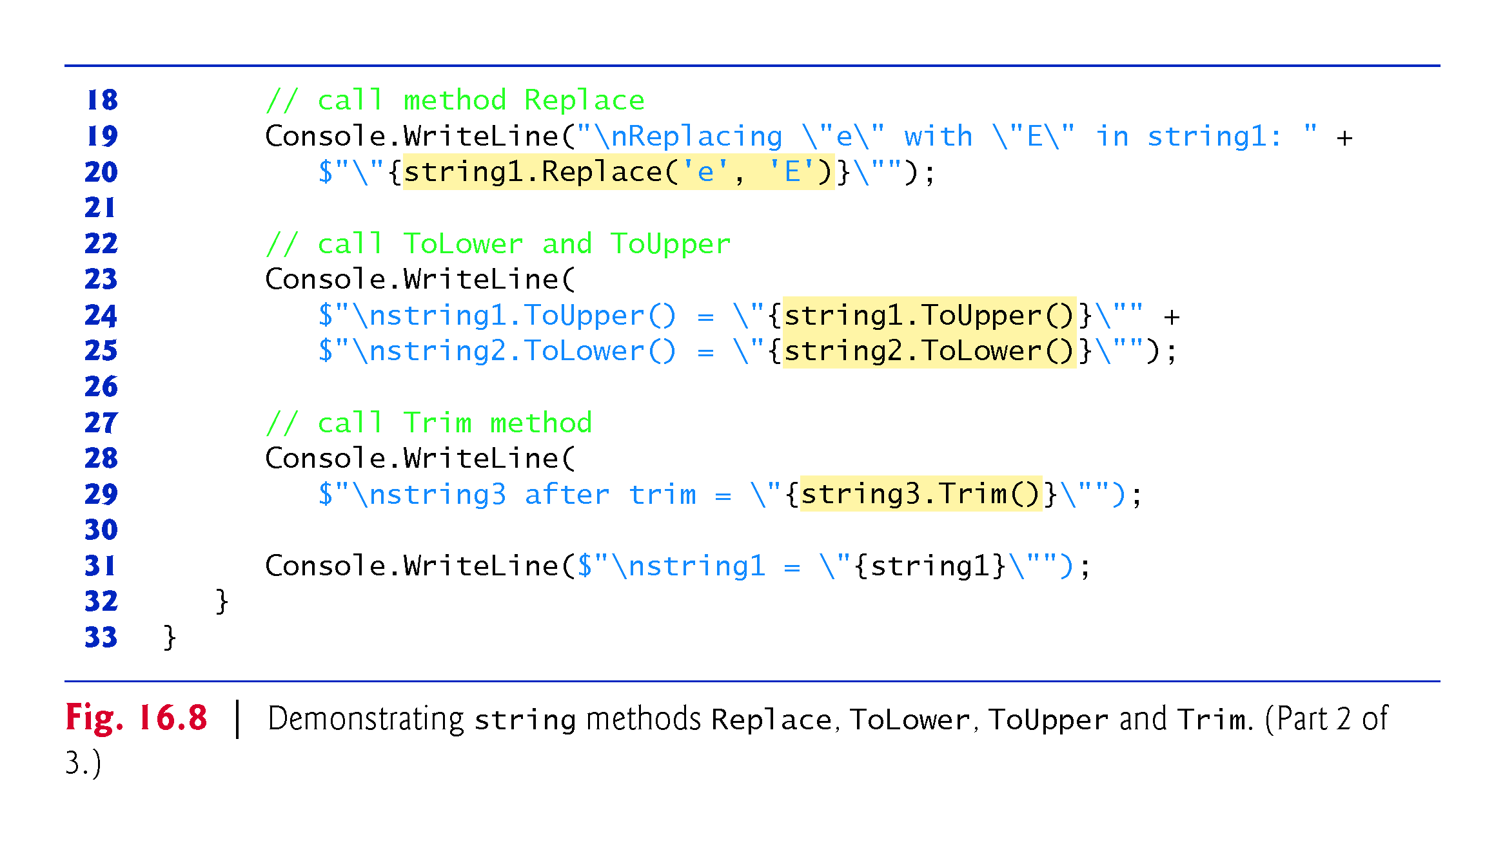

Slide 42
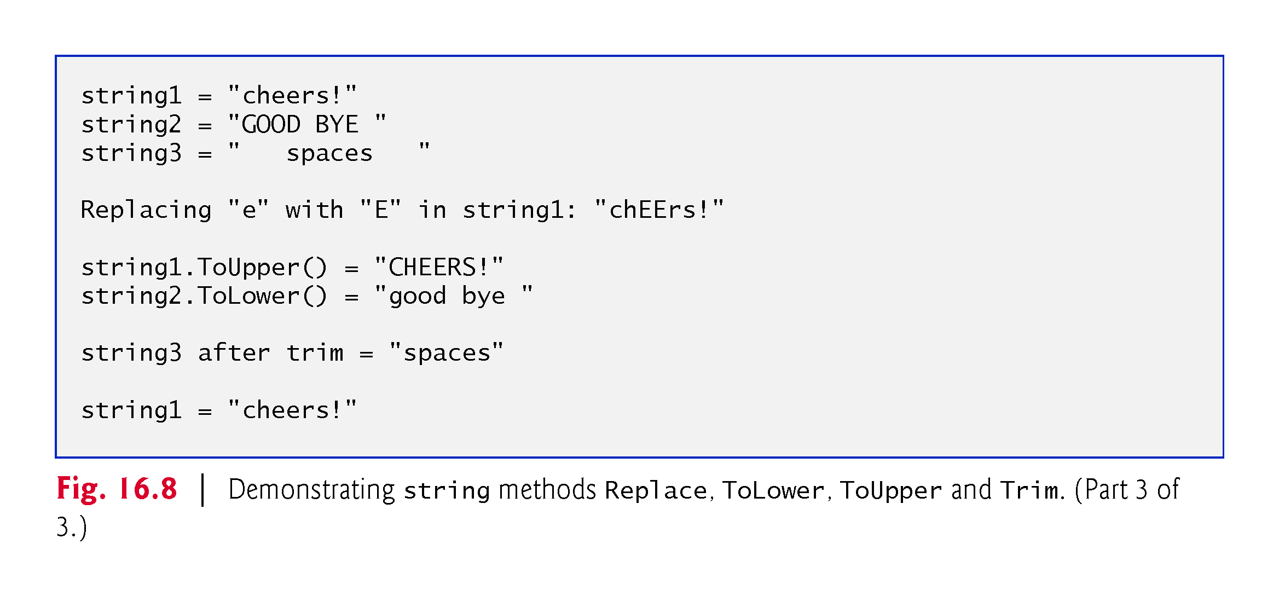

Slide 43
16.11 Class StringBuilder
The string class provides many capabilities for processing strings.
However a string’s contents can never change.
Operations that seem to concatenate strings are in fact creating new strings—the += operator creates a new string and assigns its reference to the variable on the left of the += operator.
Every StringBuilder can store a certain number of characters that’s specified by its capacity.
Exceeding the capacity of a StringBuilder causes the capacity to expand to accommodate the additional characters.

Slide 44
16.11 Class StringBuilder (cont.)
StringBuilder methods Append and AppendFormat can be used for concatenation like the operators + and += for class string.
StringBuilder is particularly useful for manipulating in place a large number of strings, as it’s much more efficient than creating individual immutable strings.

Slide 45
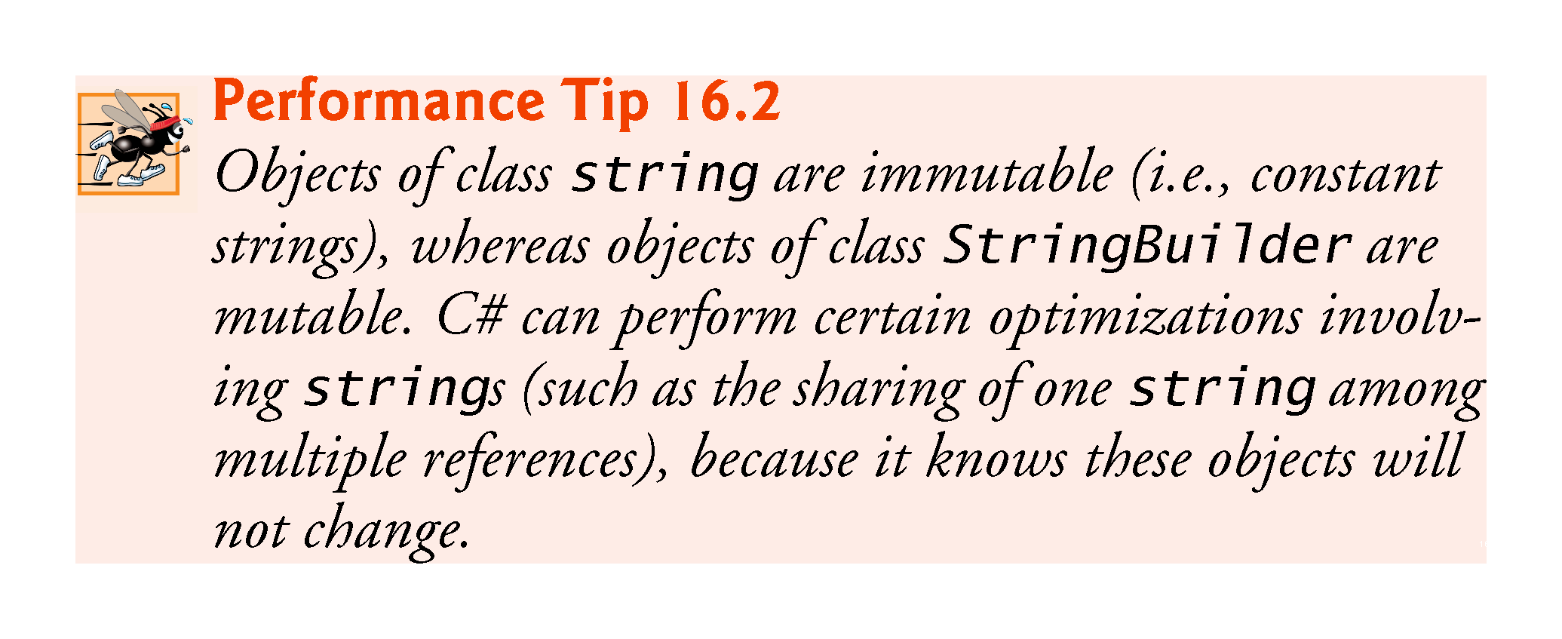

Slide 46
16.11 Class StringBuilder (cont.)
Class StringBuilderConstructor (Fig. 16.9) demonstrates some StringBuilder overloaded constructors.

Slide 47
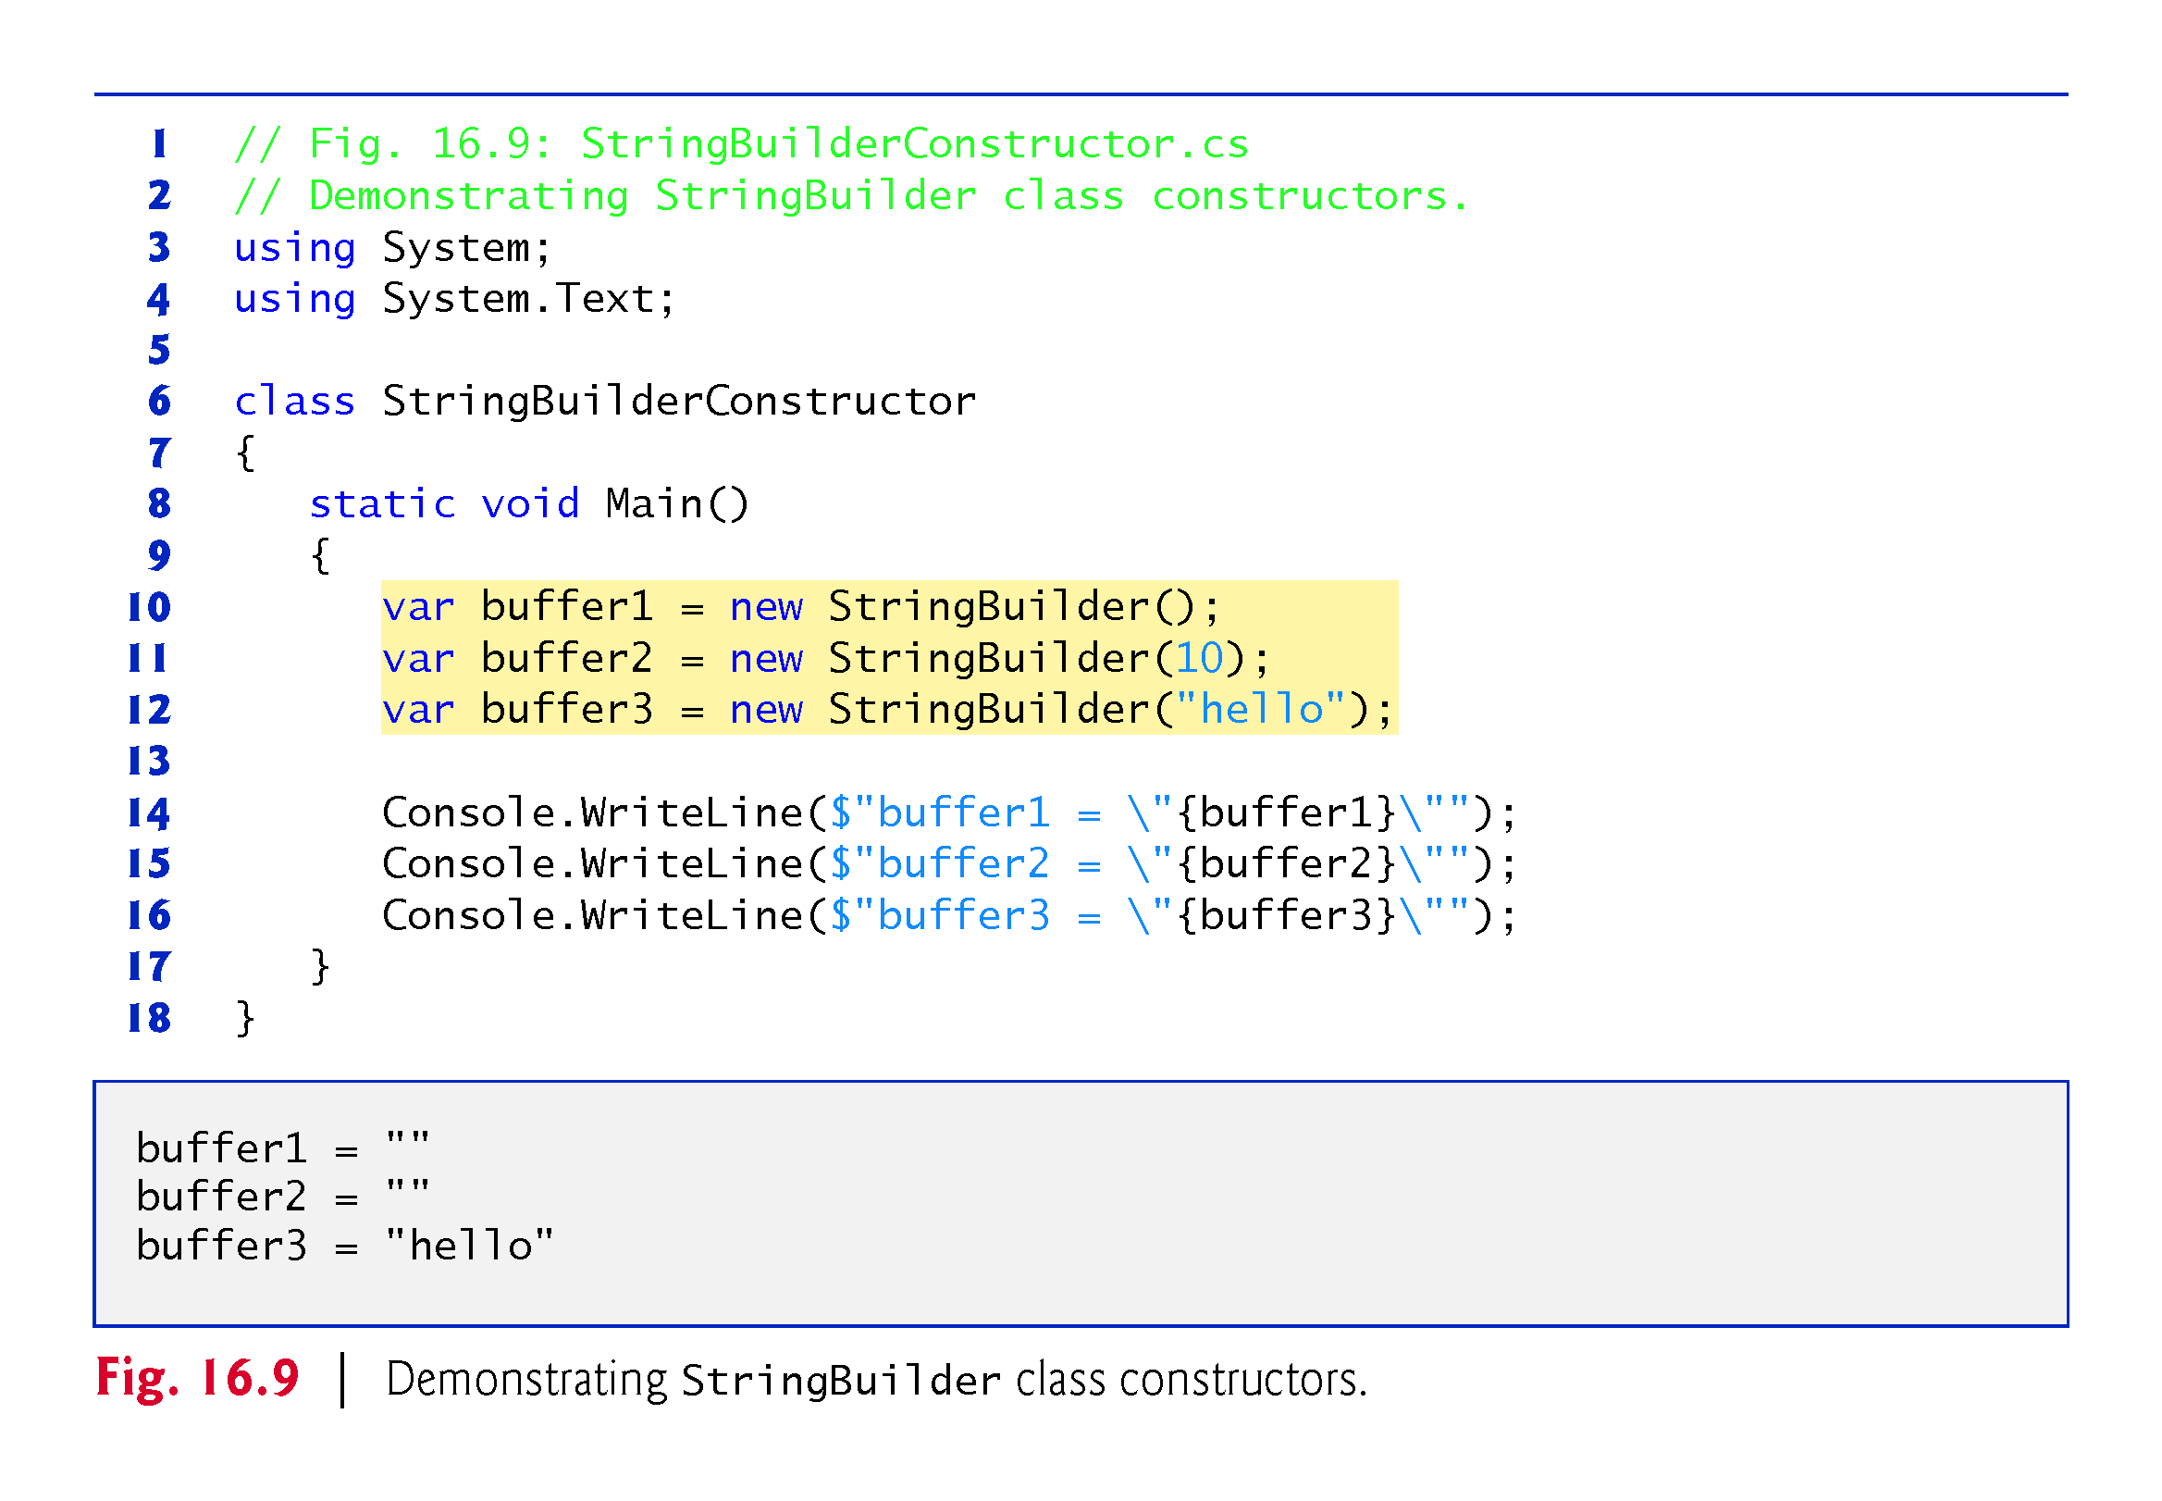

Slide 48
16.11 Length and Capacity Properties, EnsureCapacity Method and Indexer of Class StringBuilder
Class StringBuilder provides the Length and Capacity properties to return the number of characters currently in a StringBuilder and the number of characters that a StringBuilder can store without allocating more memory, respectively.
These properties also can increase or decrease the length or the capacity of the StringBuilder . Method EnsureCapacity allows you to reduce the number of times that a StringBuilder’s capacity must be increased.
The method ensures that the StringBuilder’s capacity is at least the specified value.
The program in Fig. 16.10 demonstrates these methods and properties.

Slide 49
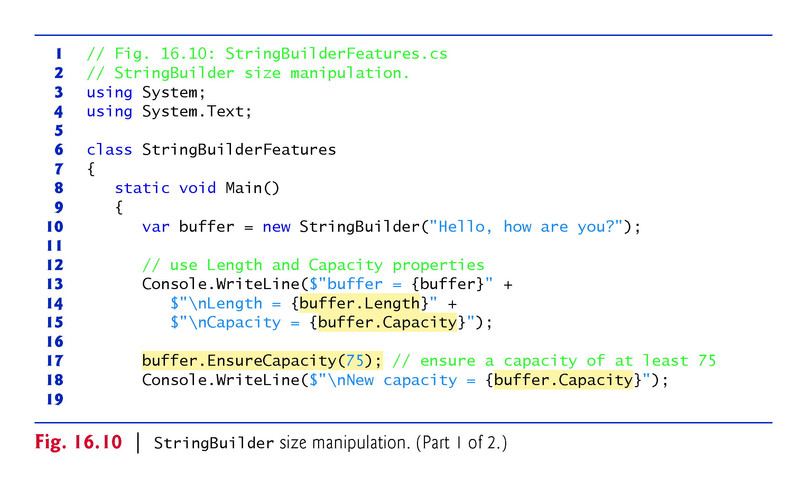

Slide 50
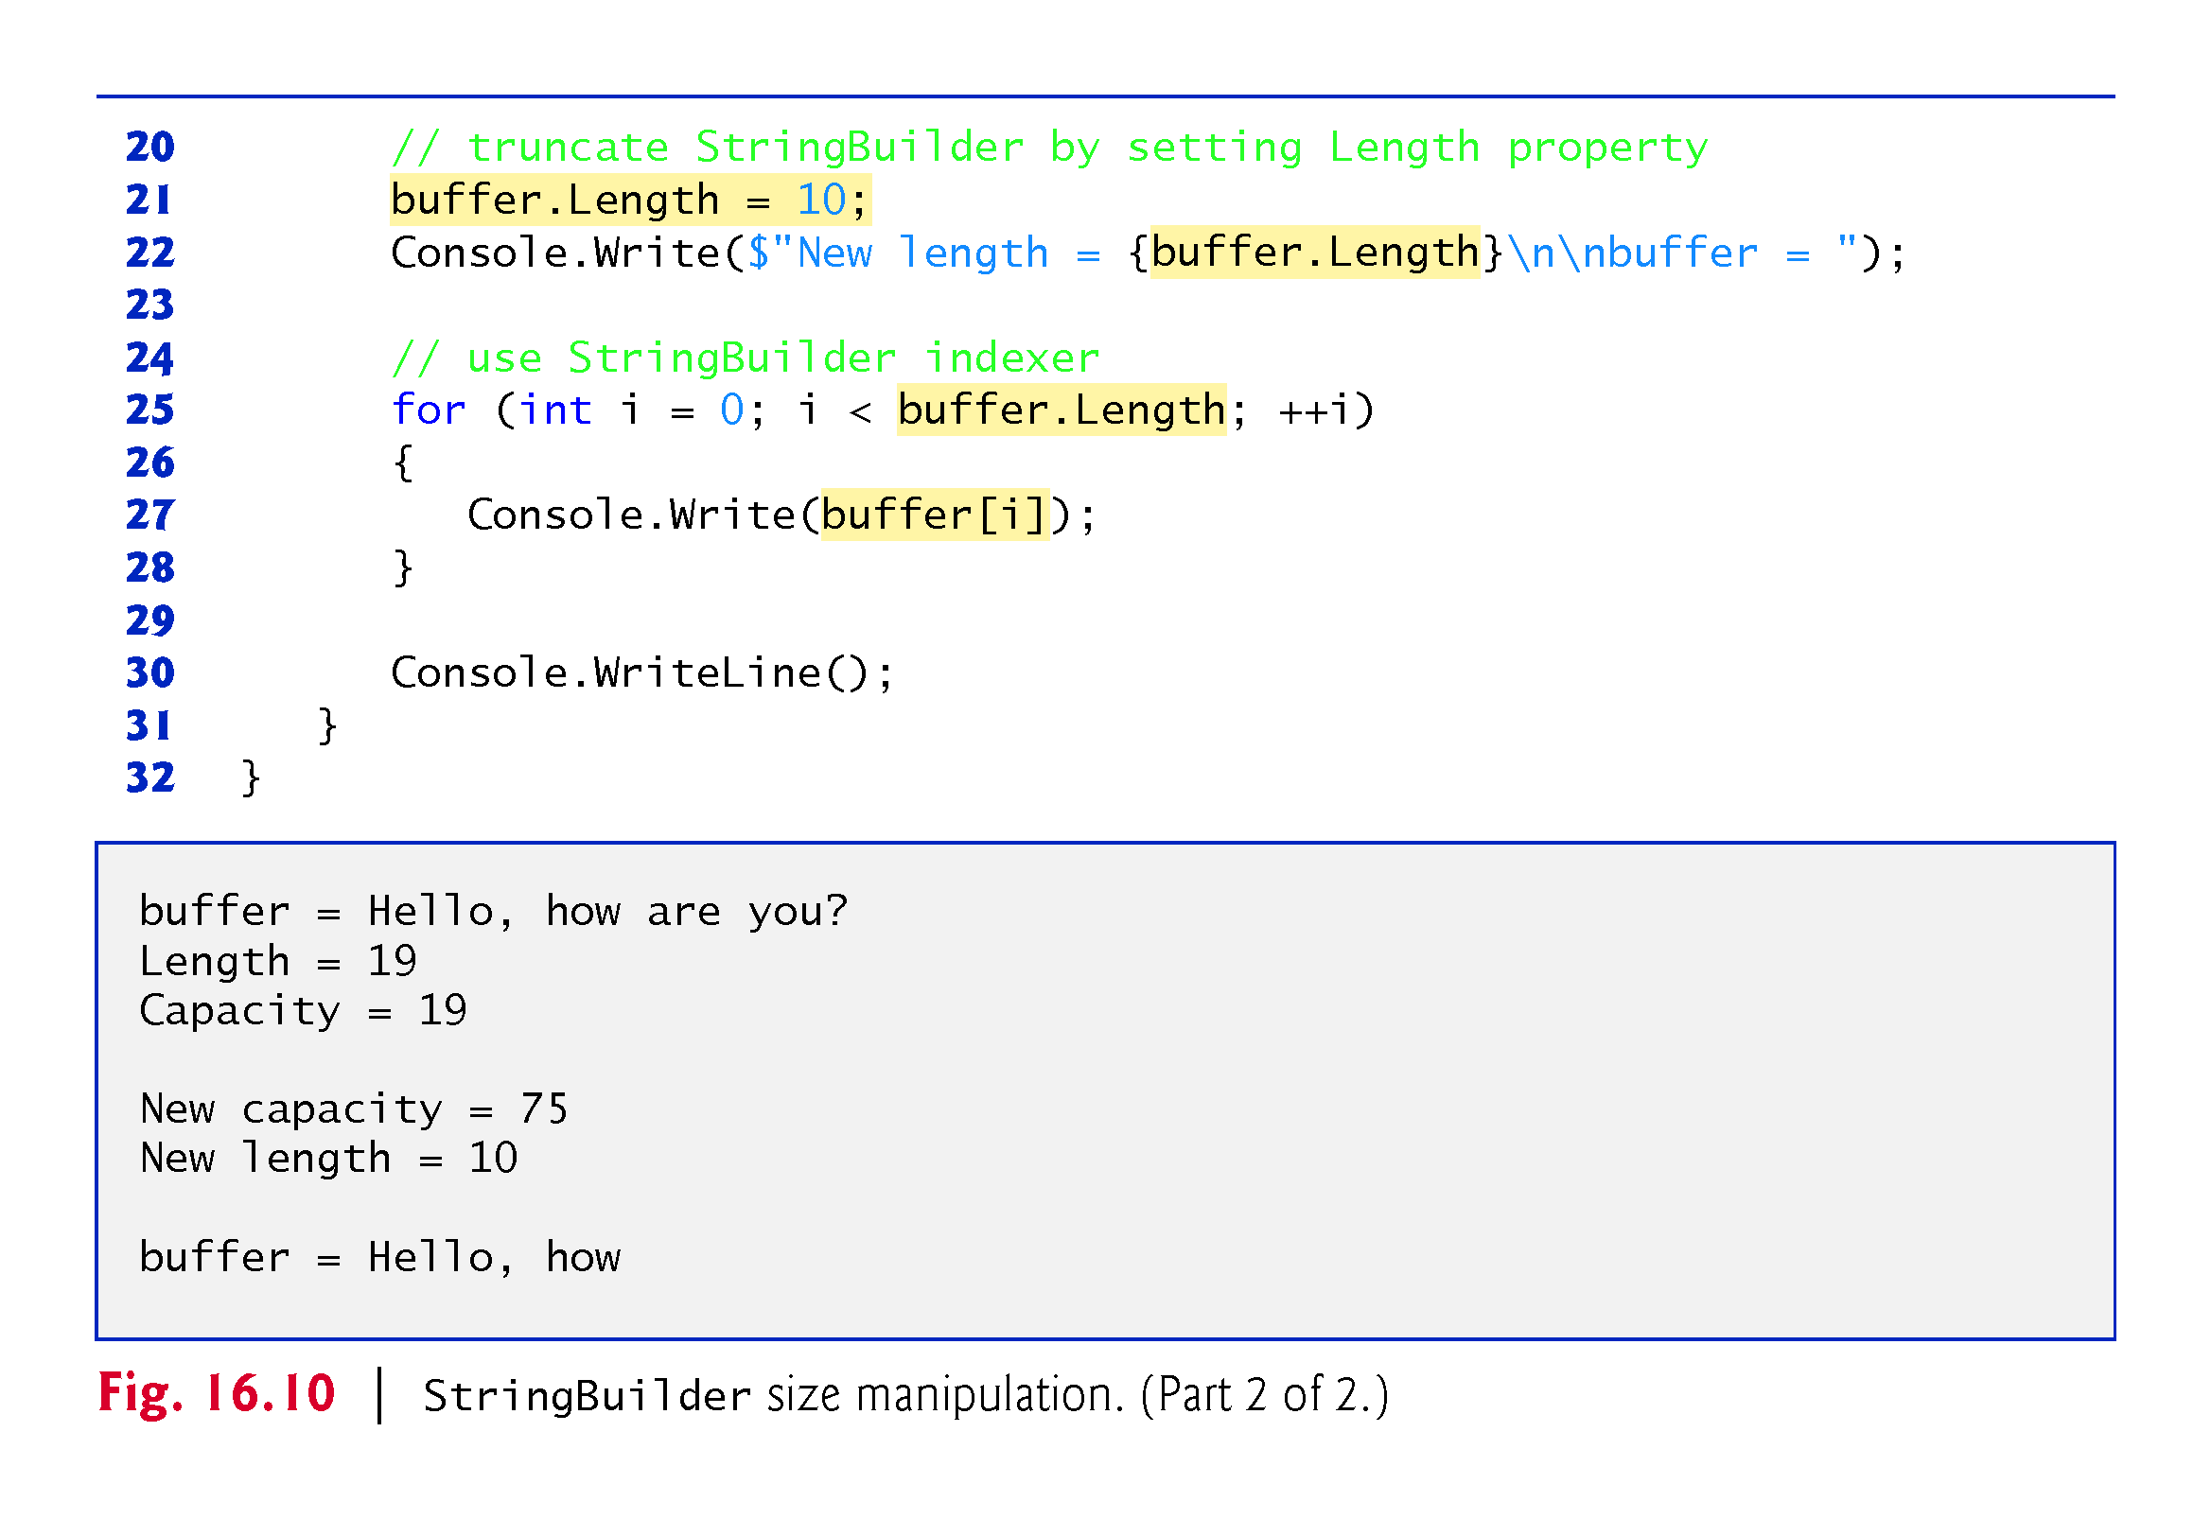

Slide 51
16.12 Append and AppendFormat Methods of Class StringBuilder
Class StringBuilder provides overloaded Append methods that allow various types of values to be added to the end of a StringBuilder .
The Framework Class Library provides versions for each of the simple types and for character arrays, strings and objects.
Each method takes an argument, converts it to a string and appends it to the StringBuilder.
Figure 16.11 demonstrates several Append methods.

Slide 52
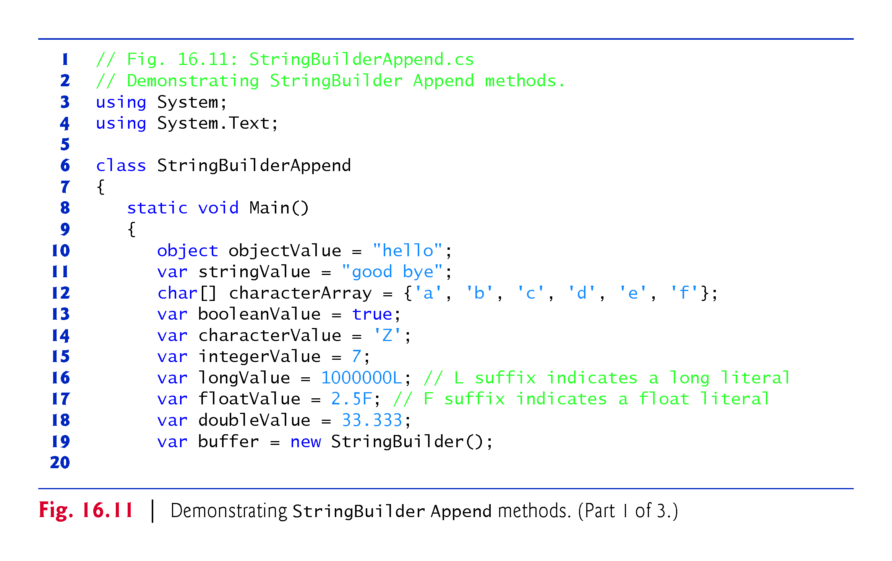

Slide 53
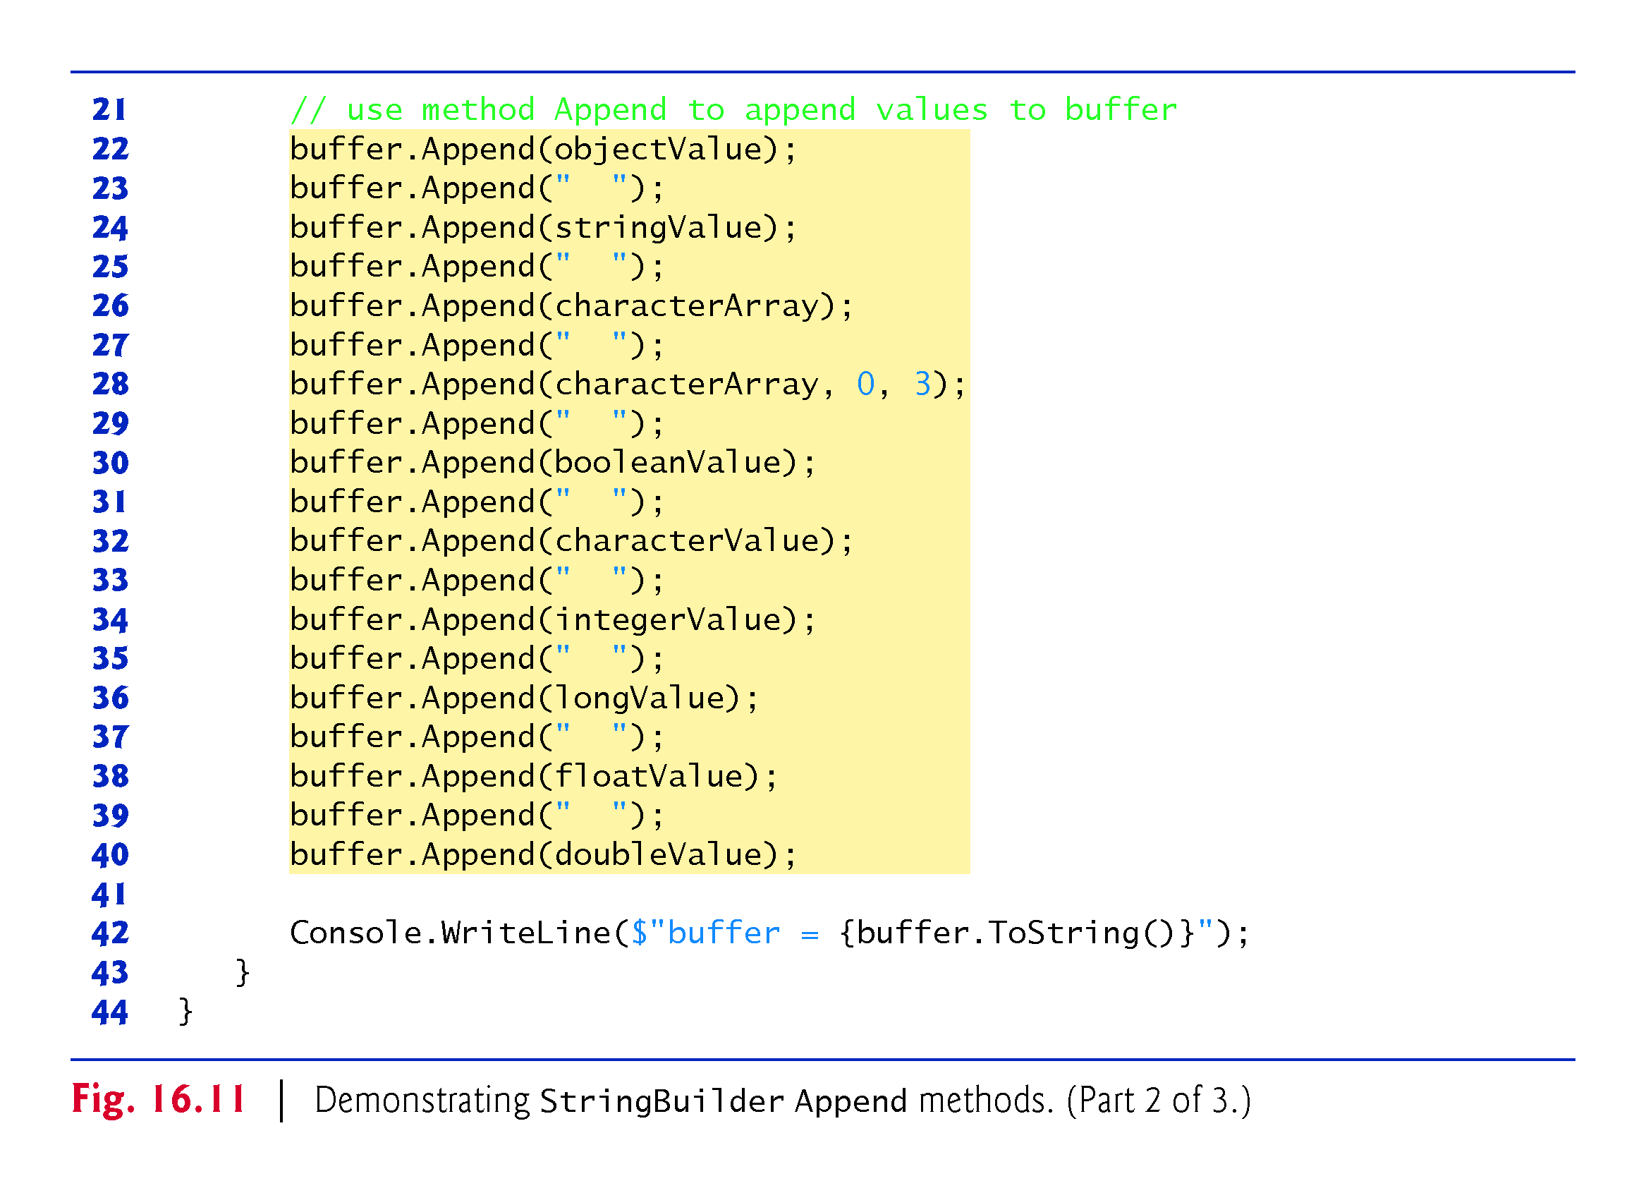

Slide 54
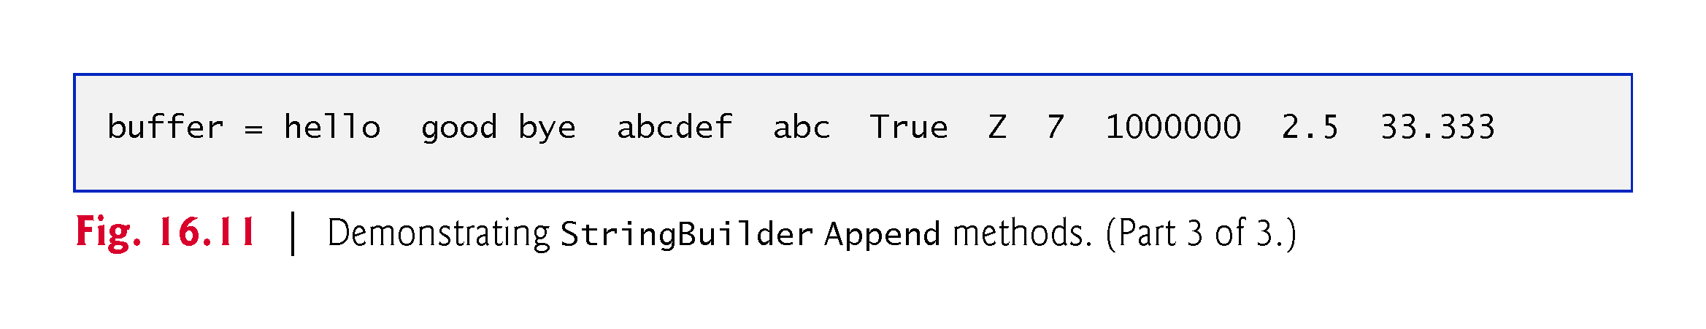

Slide 55
16.12 Append and AppendFormat Methods of Class StringBuilder
Figure 16.11 demonstrates the AppendFormat method.

Slide 56
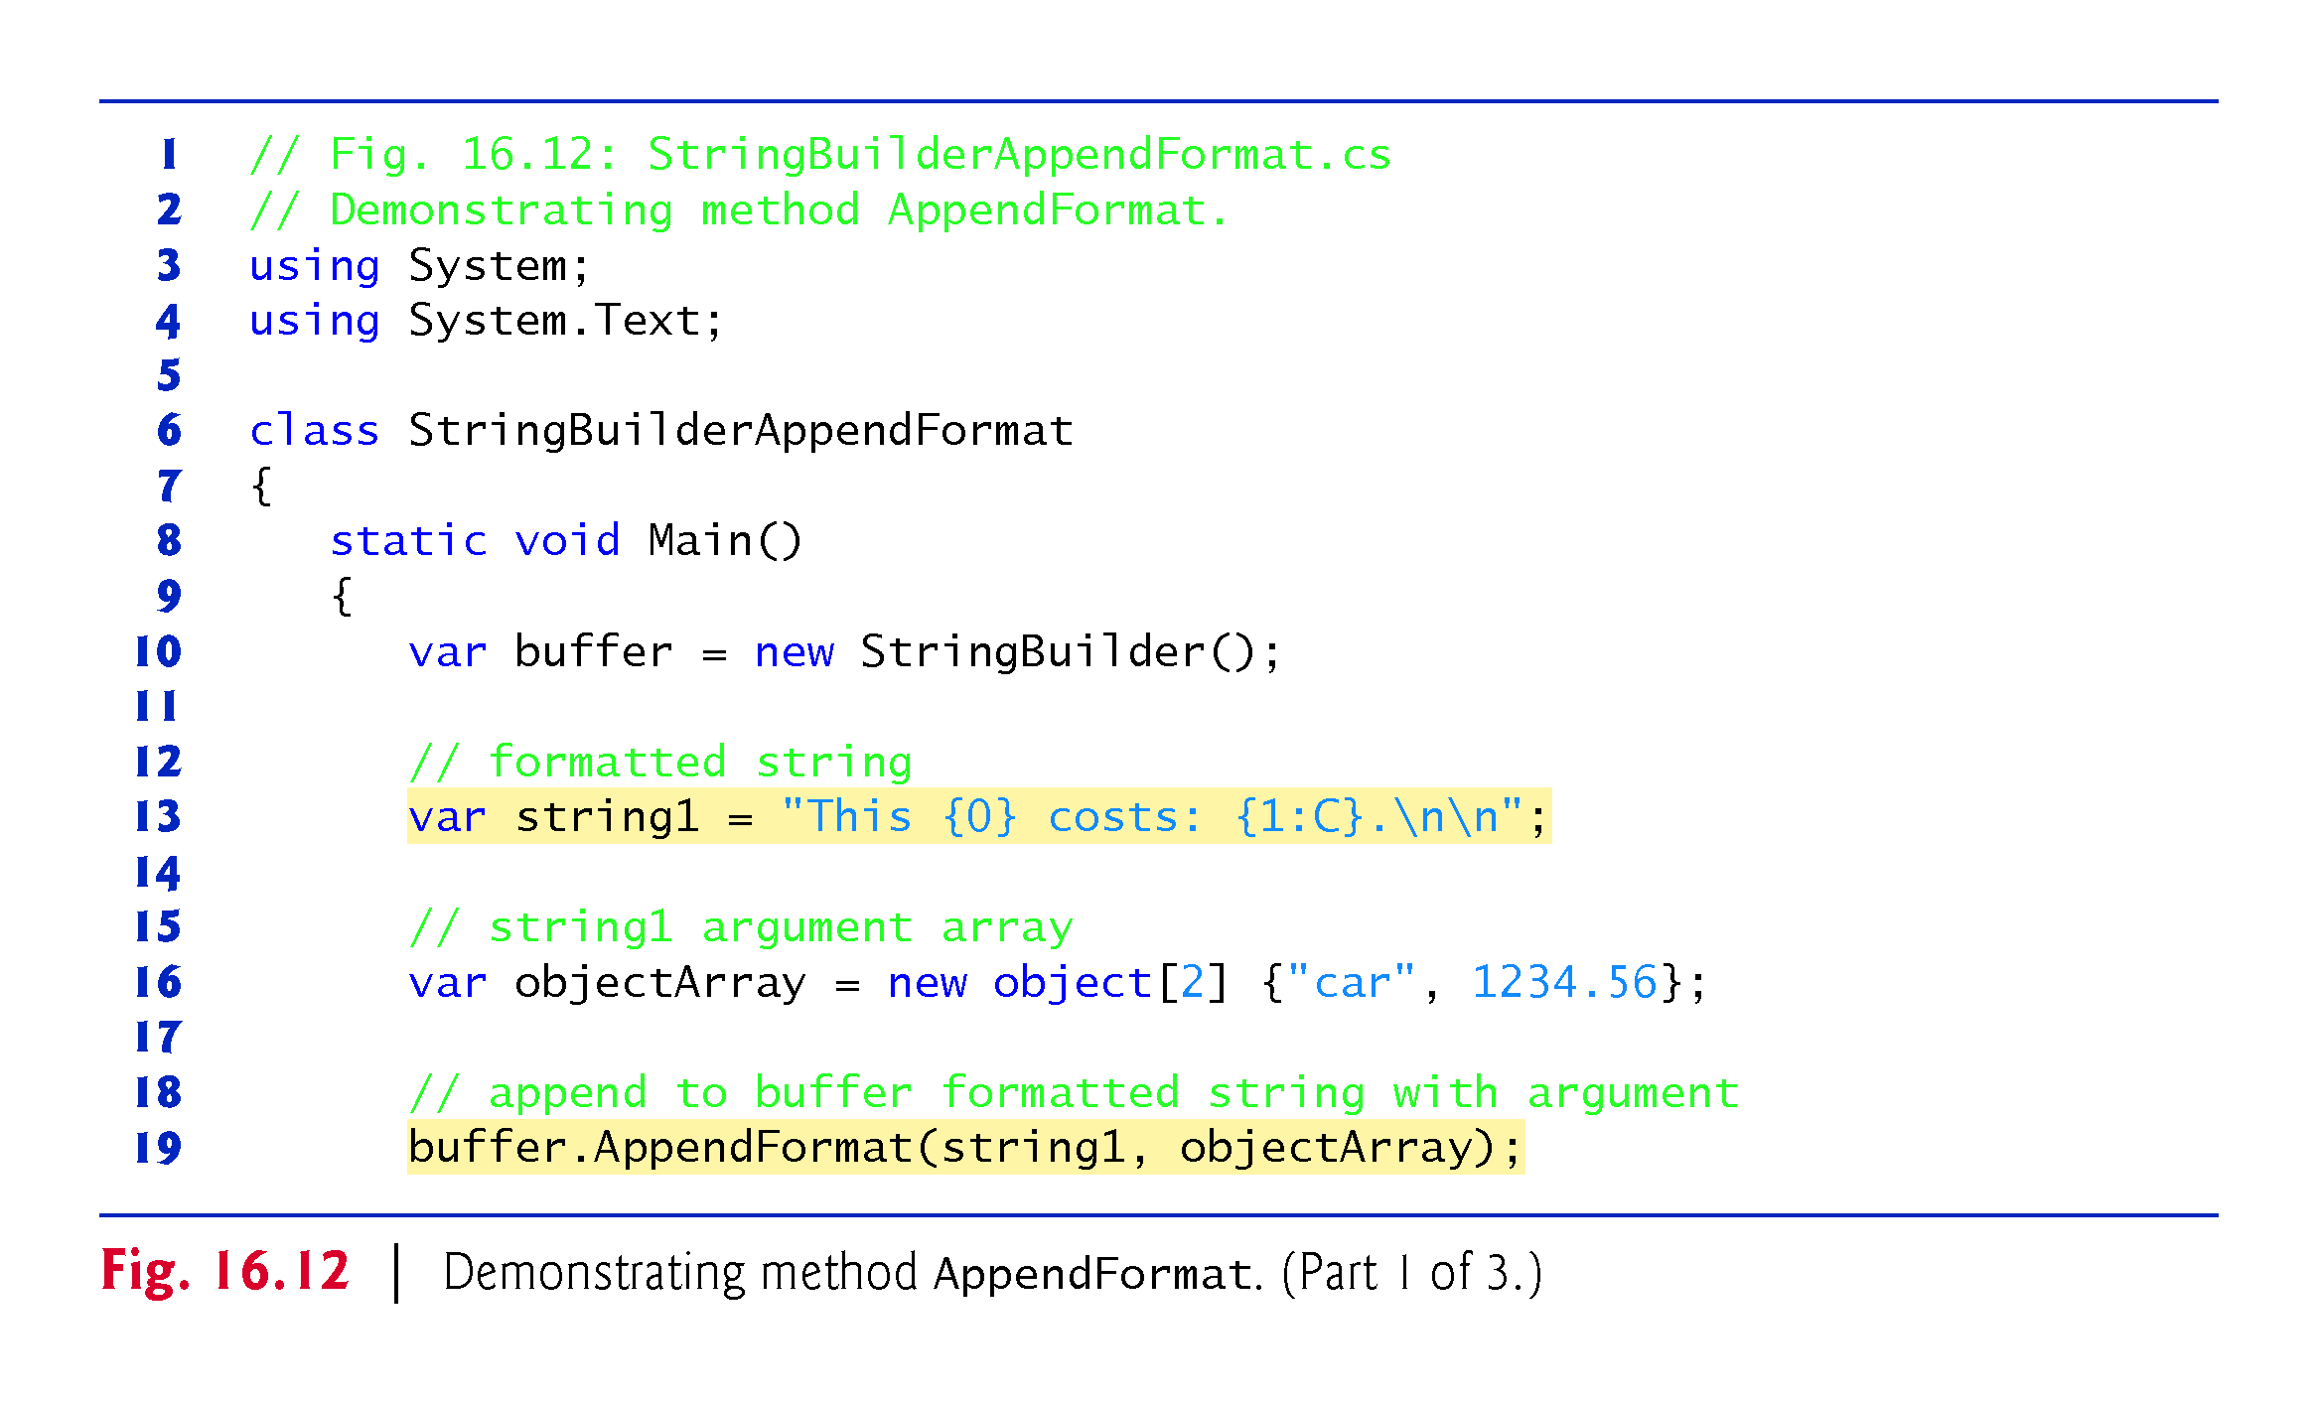

Slide 57
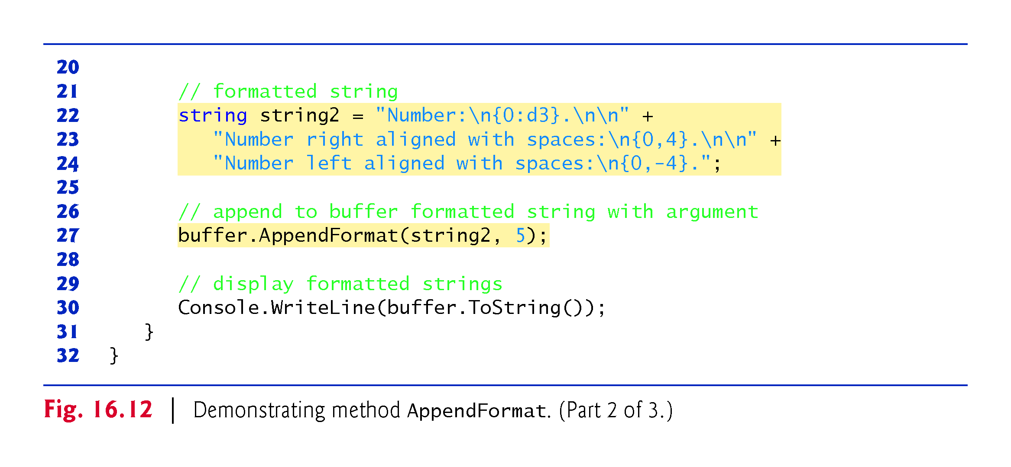

Slide 58
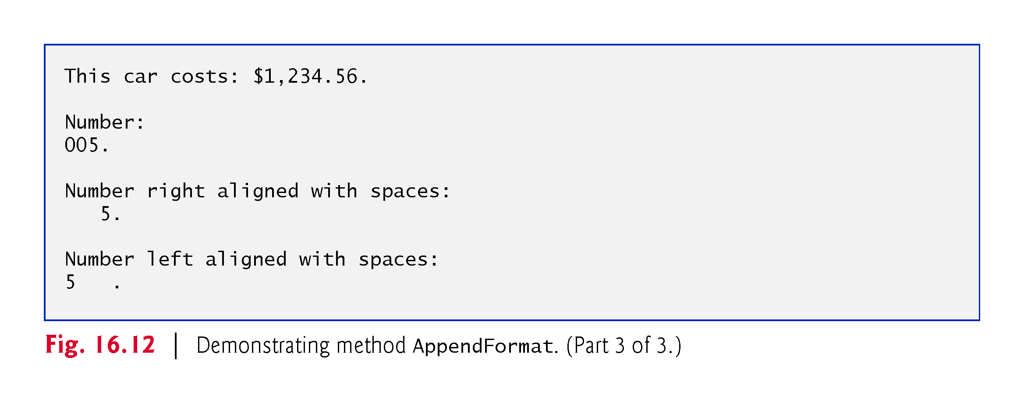

Slide 59
16.13 Insert, Remove and Replace Methods of Class StringBuilder
Class StringBuilder provides overloaded Insert methods to allow various types of data to be inserted at any position in a StringBuilder .
The class provides versions for each of the simple types and for character arrays, strings and objects.
Each method takes its second argument, converts it to a string and inserts the string into the StringBuilder in front of the character in the position specified by the first argument.
The index specified by the first argument must be greater than or equal to 0 and less than the length of the StringBuilder; otherwise, the program throws an ArgumentOutOfRangeException.

Slide 60
16.13 Insert, Remove and Replace Methods of Class StringBuilder (cont.)
Class StringBuilder also provides method Remove for deleting any portion of a StringBuilder.
Method Remove takes two arguments—the index at which to begin deletion and the number of characters to delete.
The sum of the starting index and the number of characters to be deleted must always be less than the length of the StringBuilder ; otherwise, the program throws an ArgumentOutOfRangeException.
The Insert and Remove methods are demonstrated in Fig. 16.13.

Slide 61
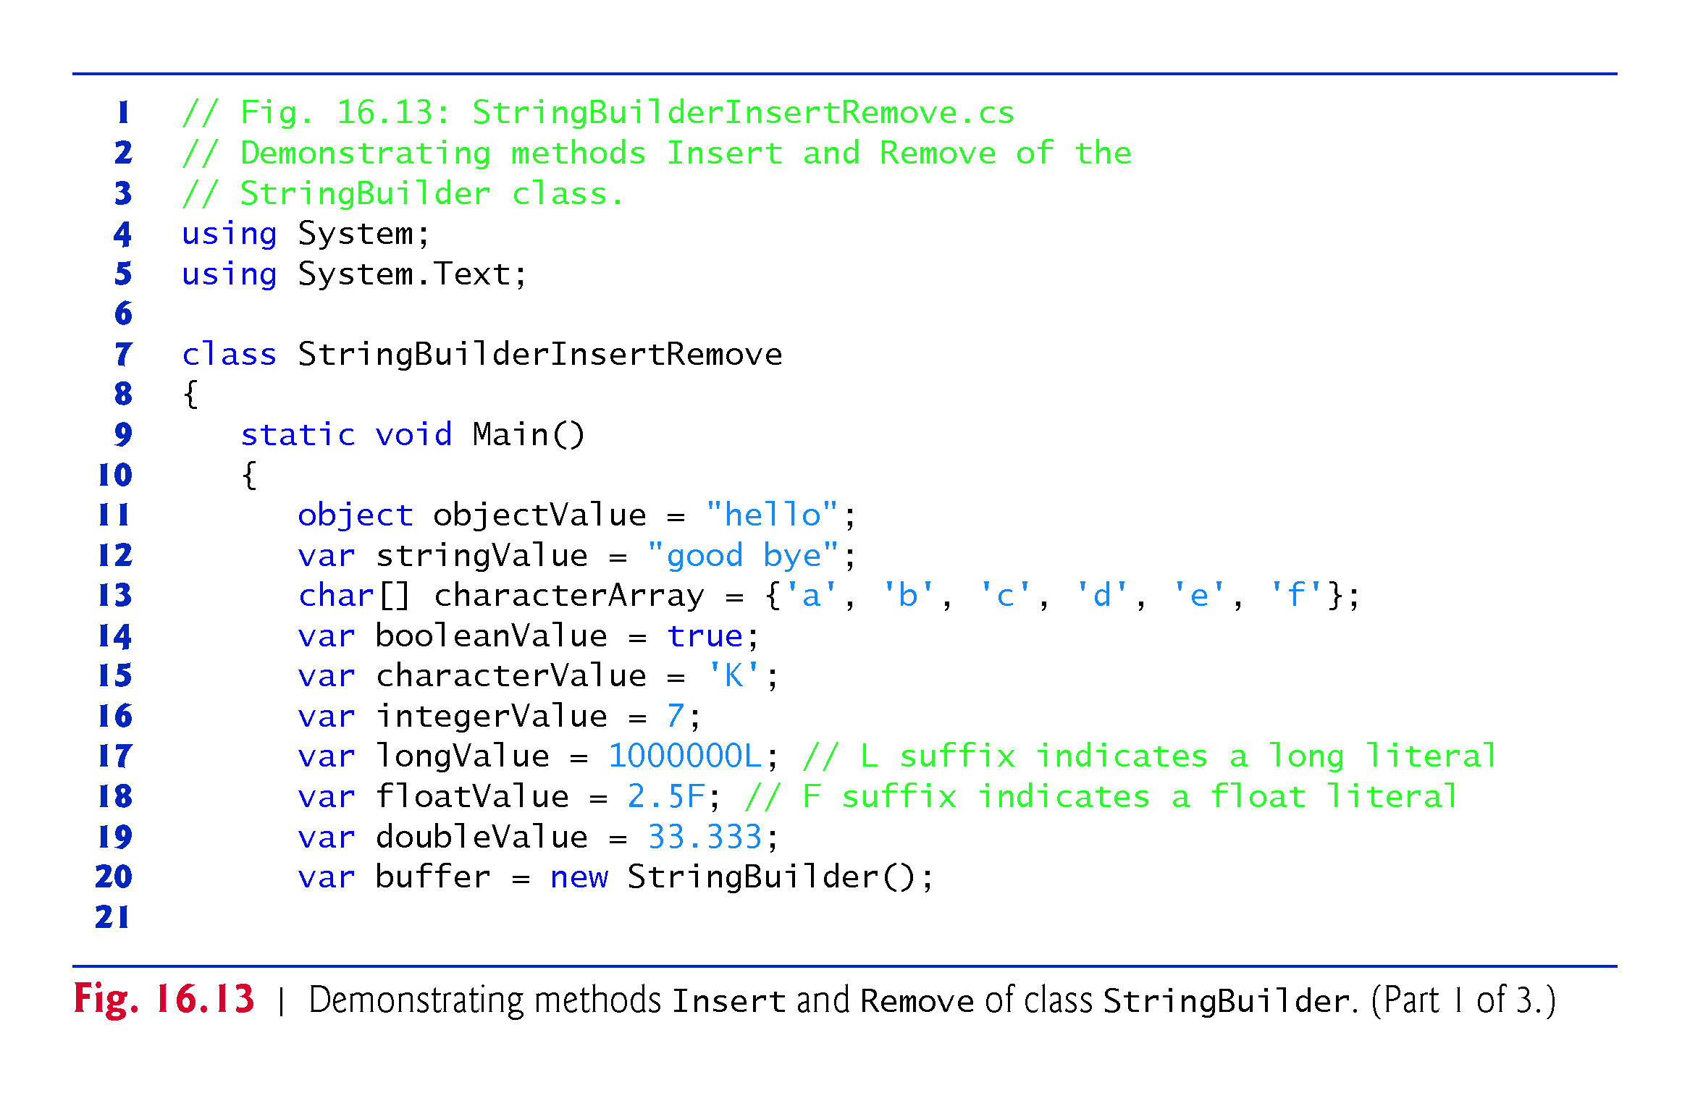

Slide 62
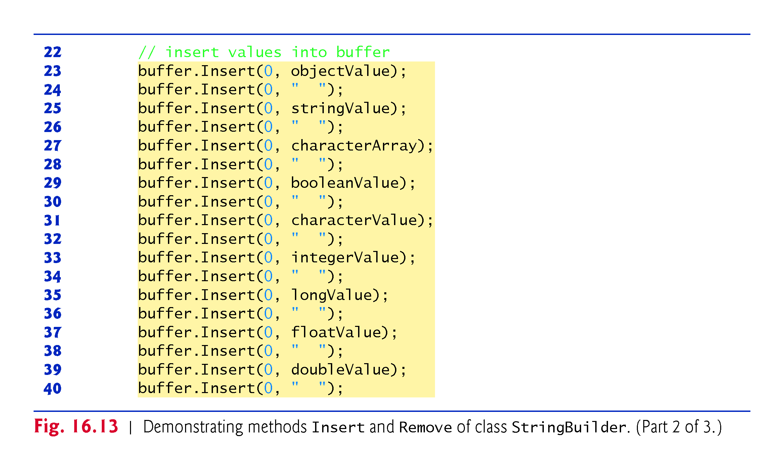
Insert from beginning

Slide 63
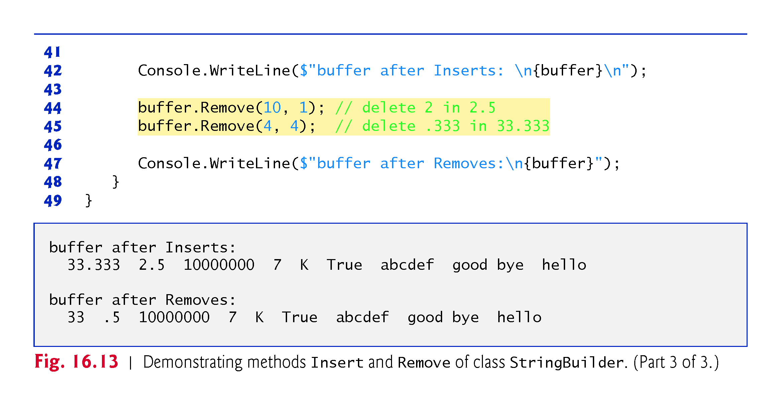

Slide 64
16.13 Insert, Remove and Replace Methods of Class StringBuilder (cont.)
StringBuilder method Replace searches for a specified string or character and substitutes another string or character in its place.
Figure 16.14 demonstrates this method.

Slide 65
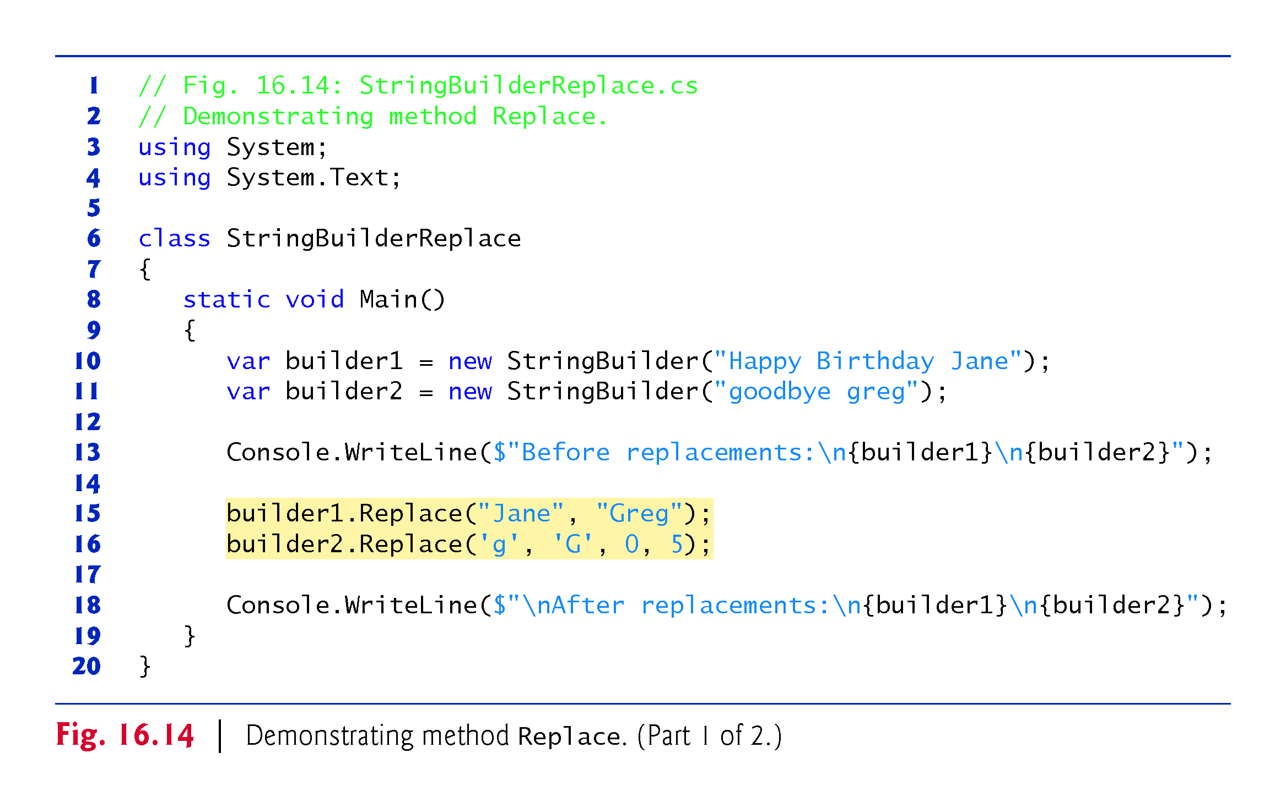

Slide 66
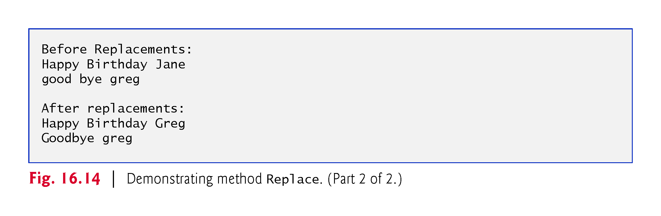

Slide 67
16.14 Char Methods
Figure 16.15 demonstrates static methods that test characters to determine whether they’re of a specific character type and static methods that perform case conversions on characters.

Slide 68
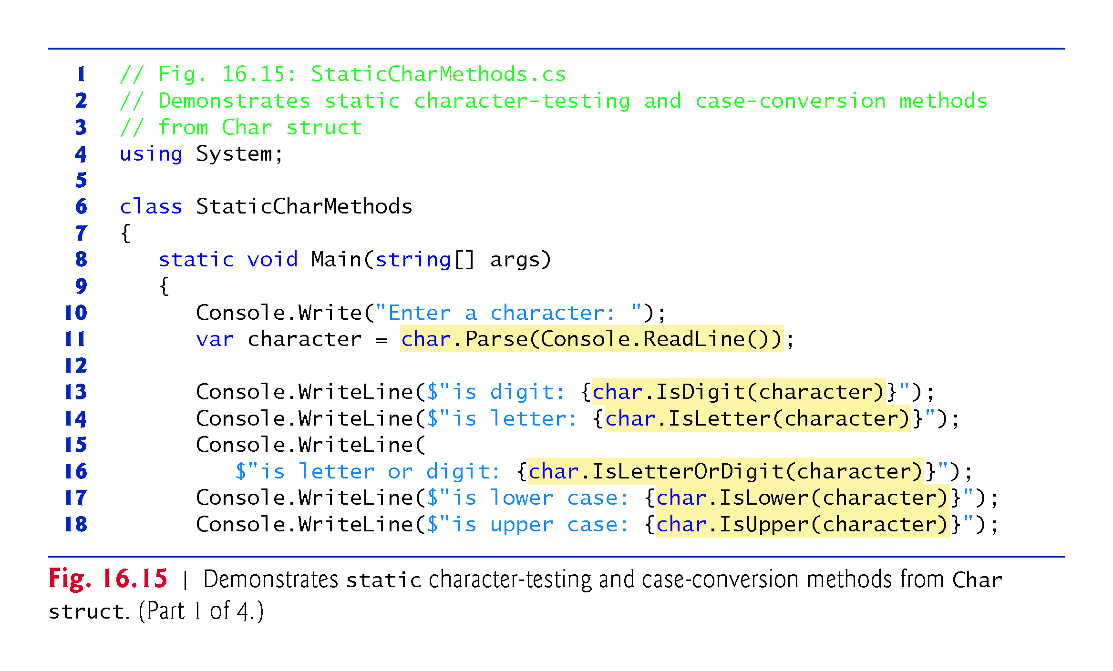

Slide 69
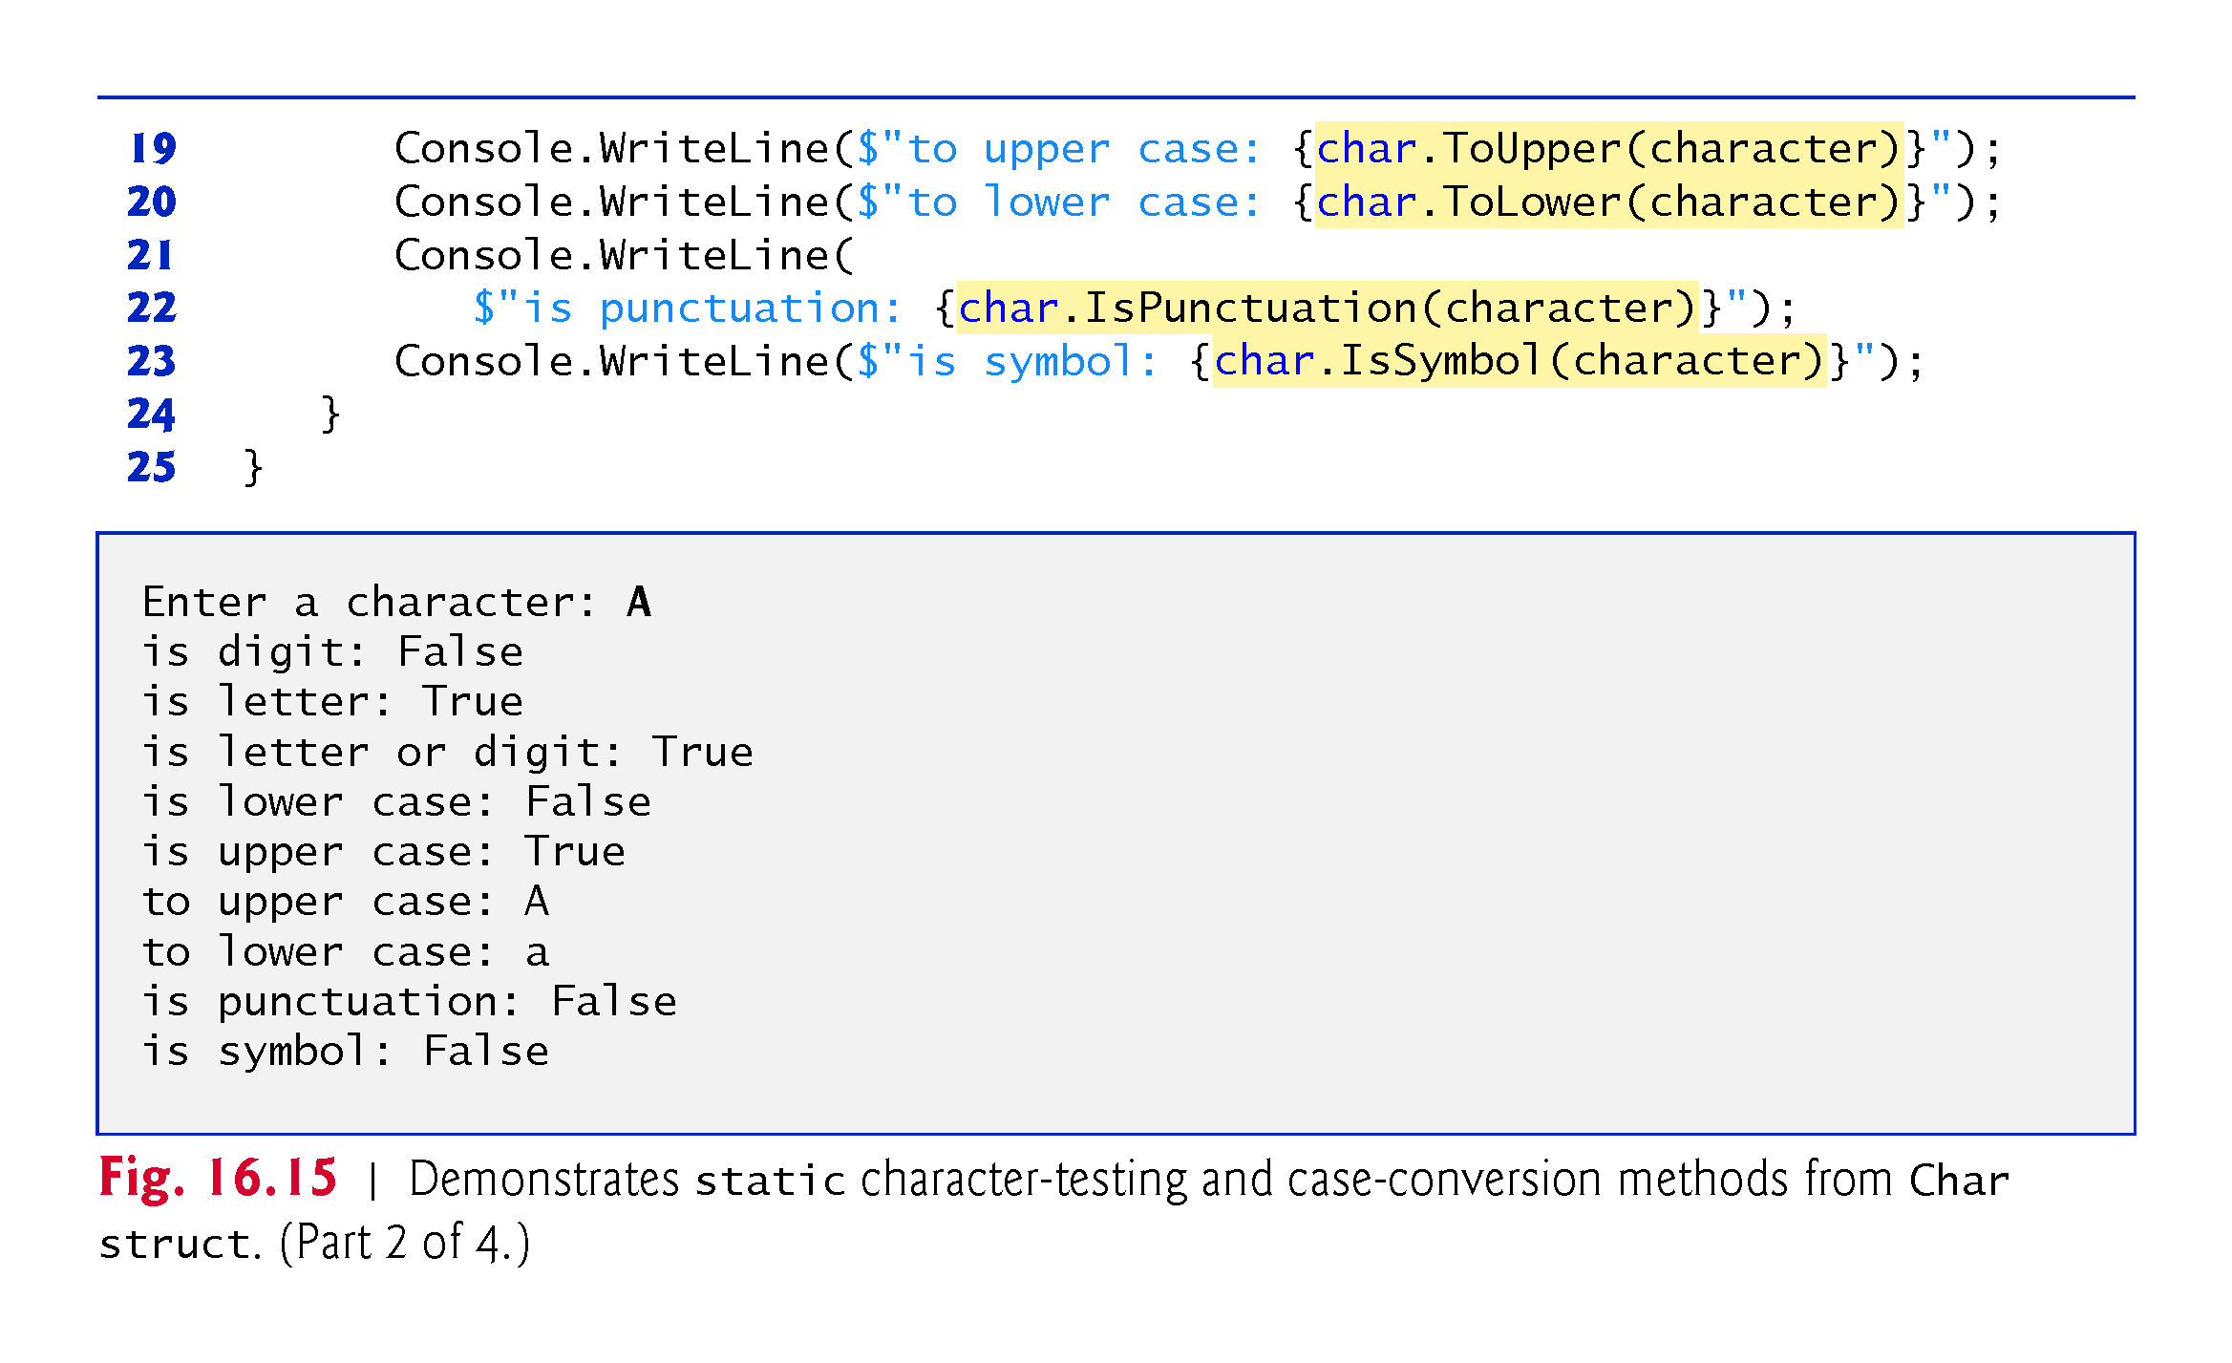

Slide 70
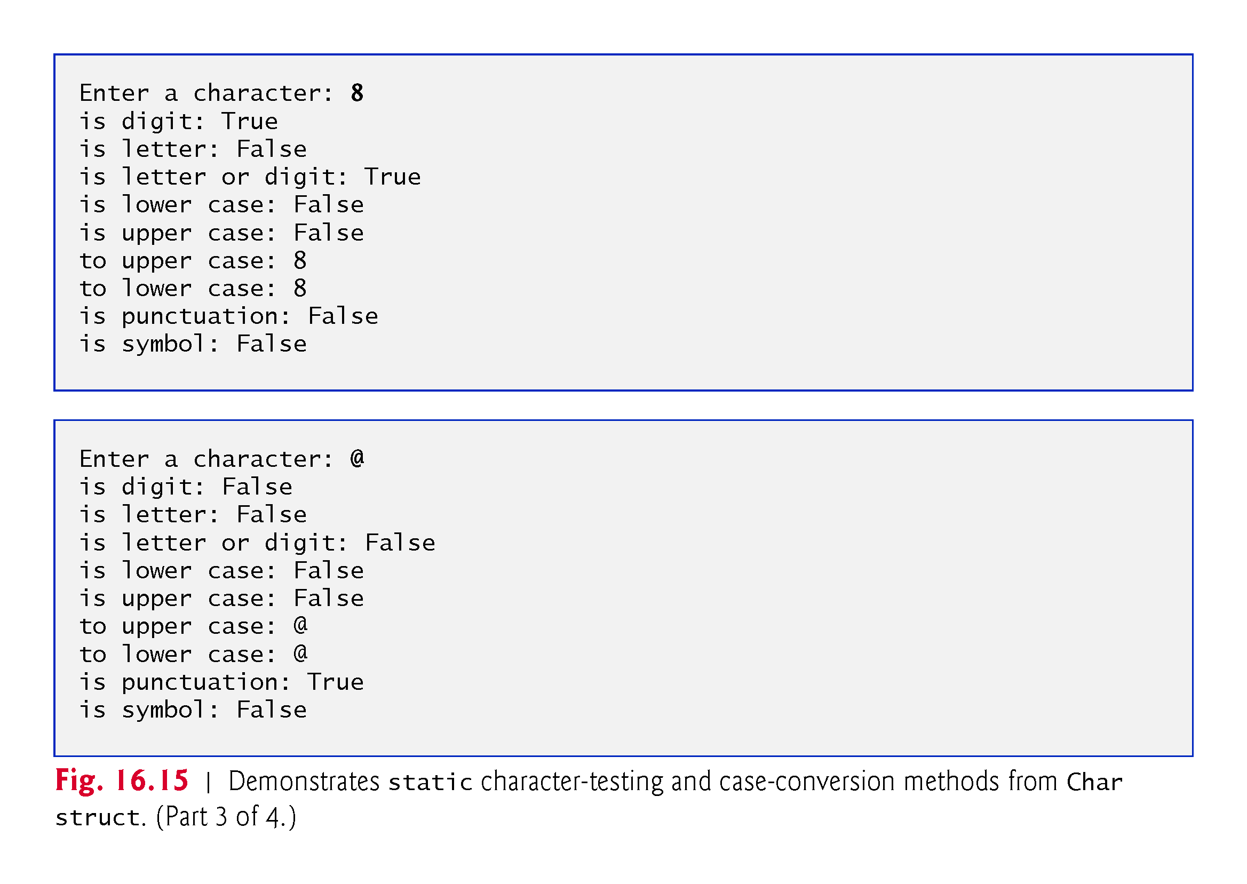

Slide 71
